Slide 1

TRANSFORMER ATTENSION IS ALL YOU NEED

Slide 2

It’s Me !!!!!
Jai Ganesh HCL Technologies Senior Lead Engineer R & D - Microsoft

Slide 3
WHY NOT RNN ?
Still Sequential and takes more time to learn Also cannot handle a very long text say 1000 words (Not that effective to handle the longer sequences.)
RNN Slower in process. (LSTM also slower in process)
RNN expects to give the input in serially or sequentially to process them and such sequential flow doesn’t make use of the GPU very well which developed for parallel computation.
CAN WE USE THE PARALLIZATION FOR SEQUENTIAL DATA???

Slide 4
WHAT IS TRANSFORMER ?
The transformer neural network is a novel architecture that aims to solve sequence-to-sequence tasks while handling long-range dependencies with ease.
A deep learning architecture that relies on the parallel multi-head attention mechanism. (Parellelize the Sequential Data)
“Attention Is All You Need” presents a novel approach to sequence-to-sequence tasks that relies solely on self-attention mechanisms, without using recurrence or convolution. And this novel shaping the way we think about and approach NLP problems.
The transformer network employs the “Encoder & Decoder” architecture. The input sequence can pass in parallel to the architectures.

Slide 5
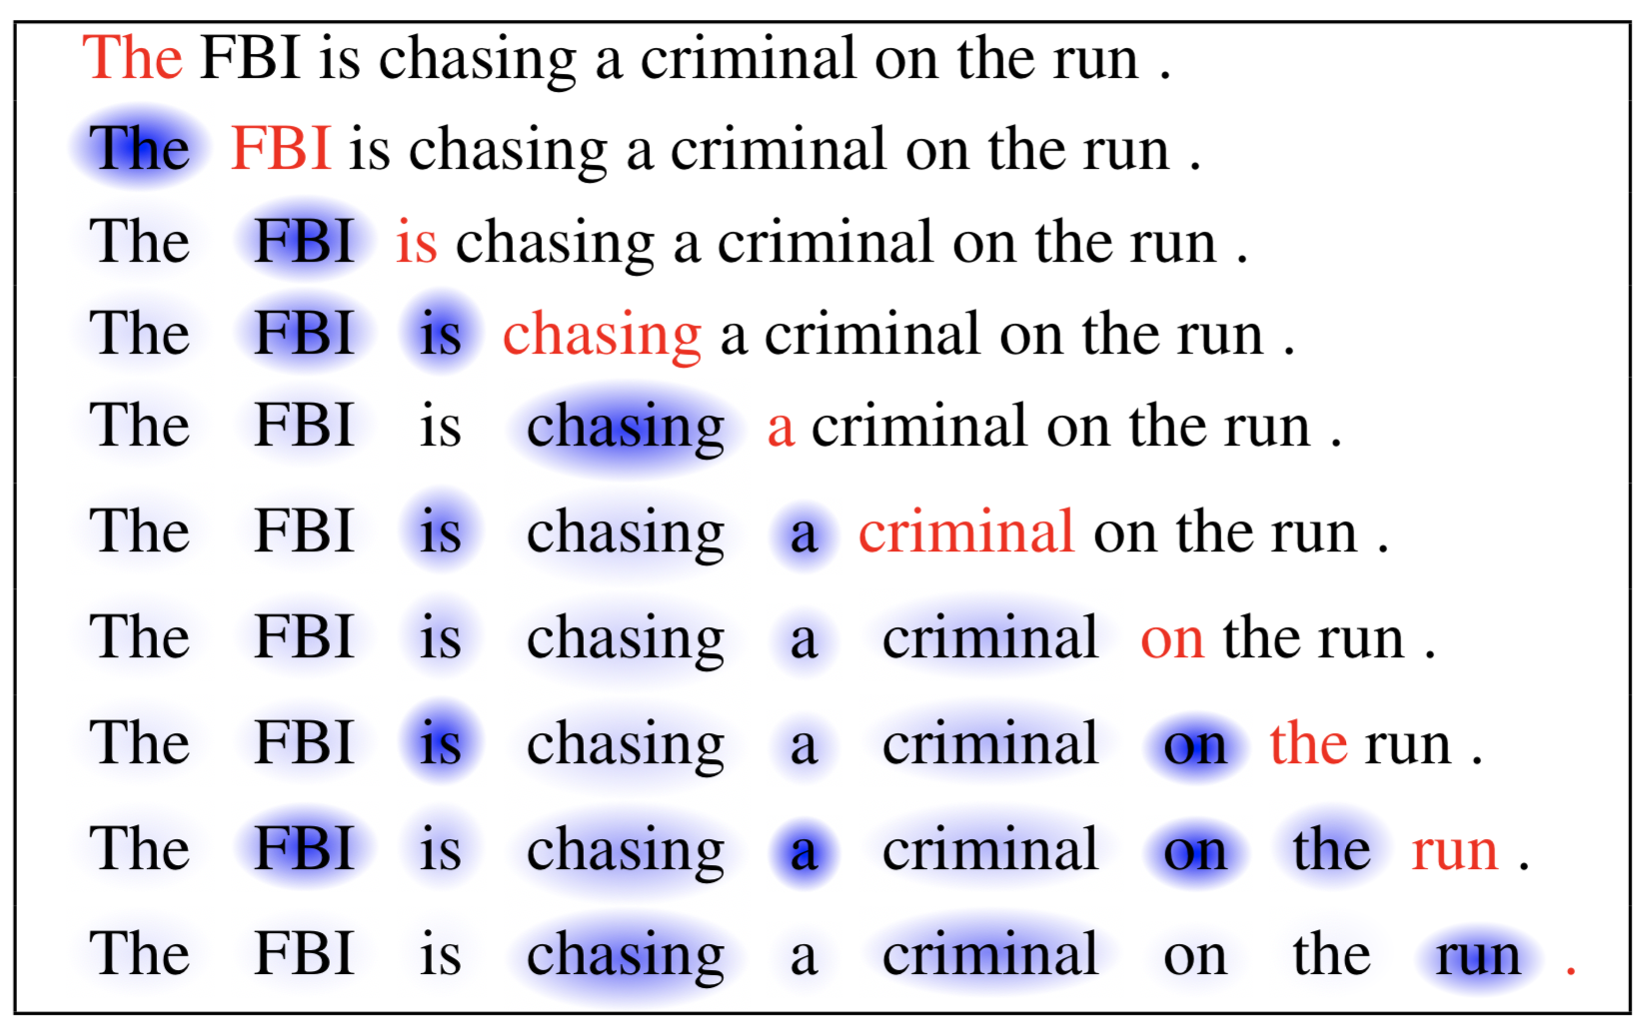
WHAT IS ATTENTION ?
The attention mechanism is a part of a
neural architecture that enables to
dynamically highlight relevant features
of the input data, which, in NLP, is typically
a sequence of textual elements.

Slide 6
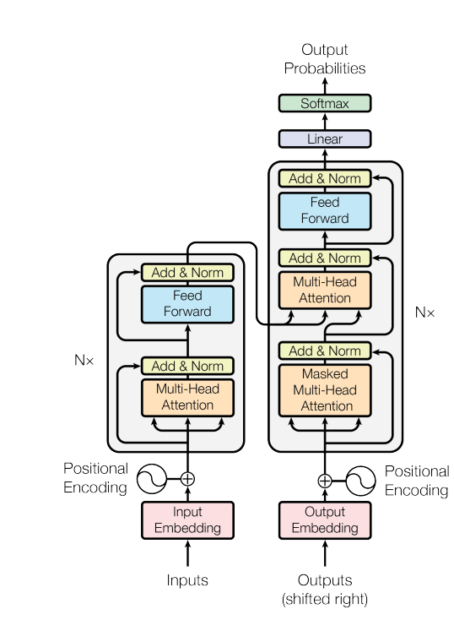

Slide 7
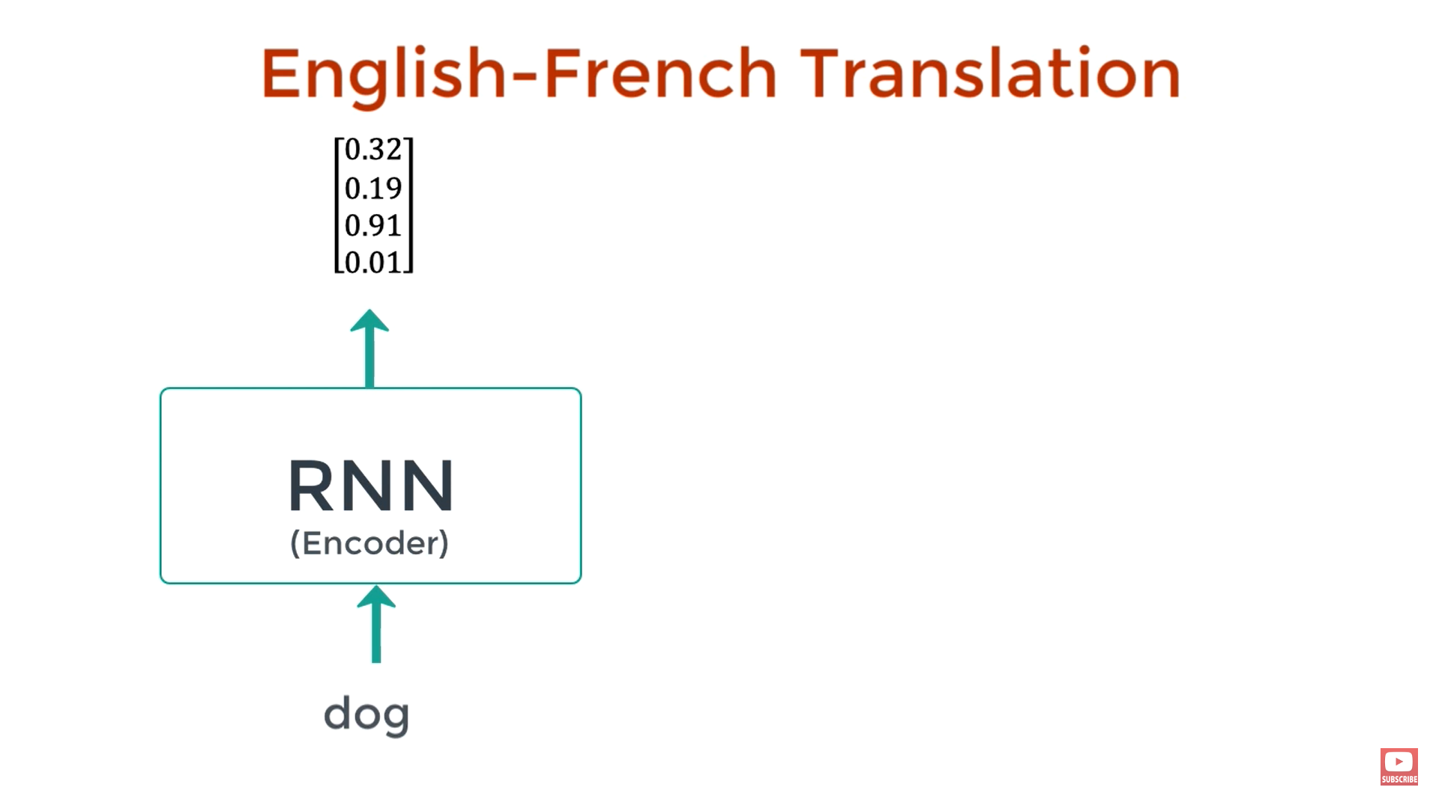

Slide 8
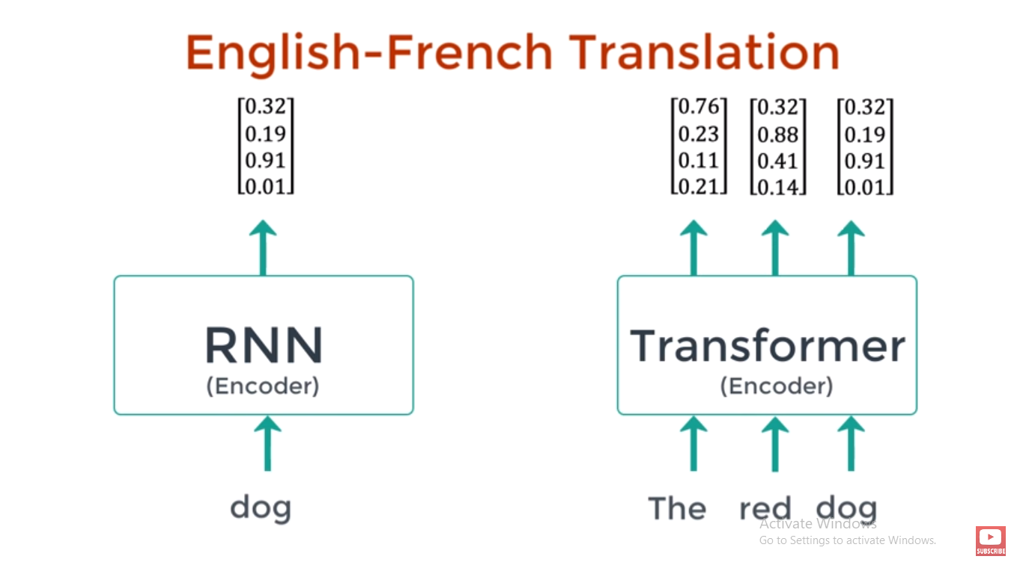

Slide 9
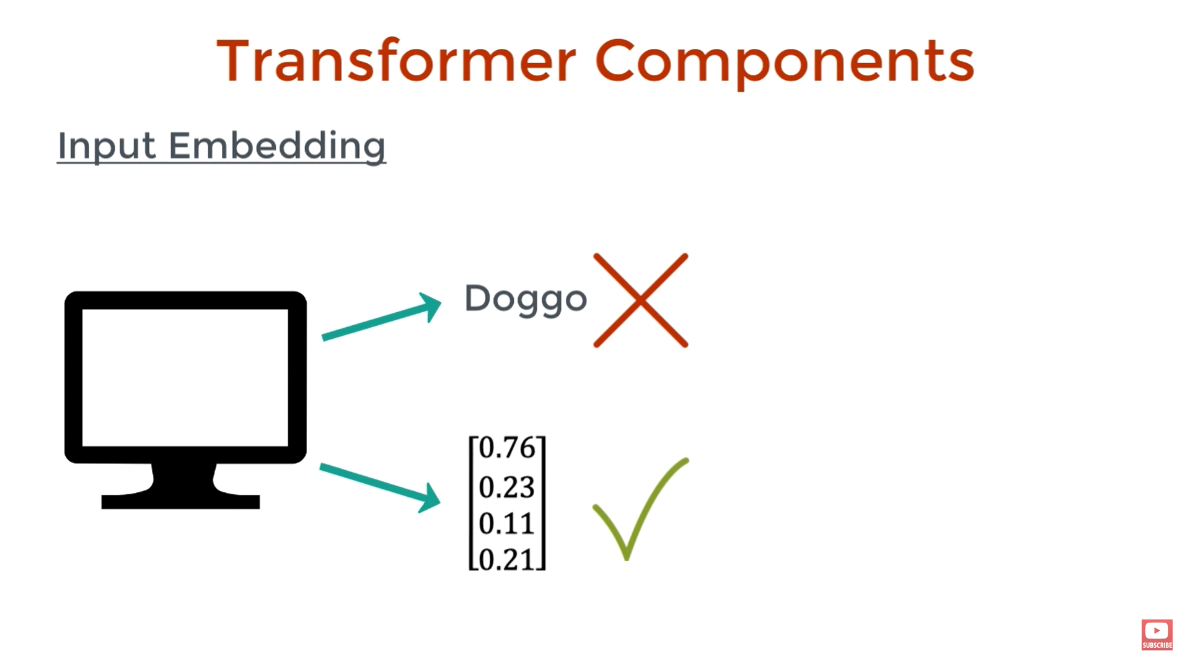

Slide 10
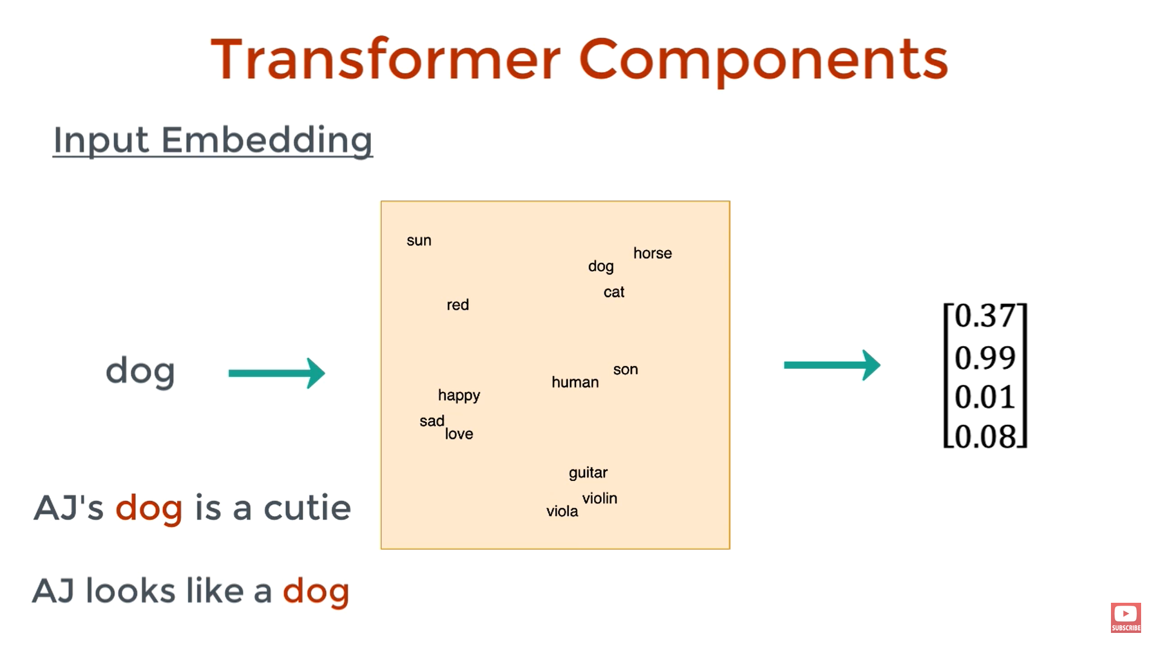

Slide 11
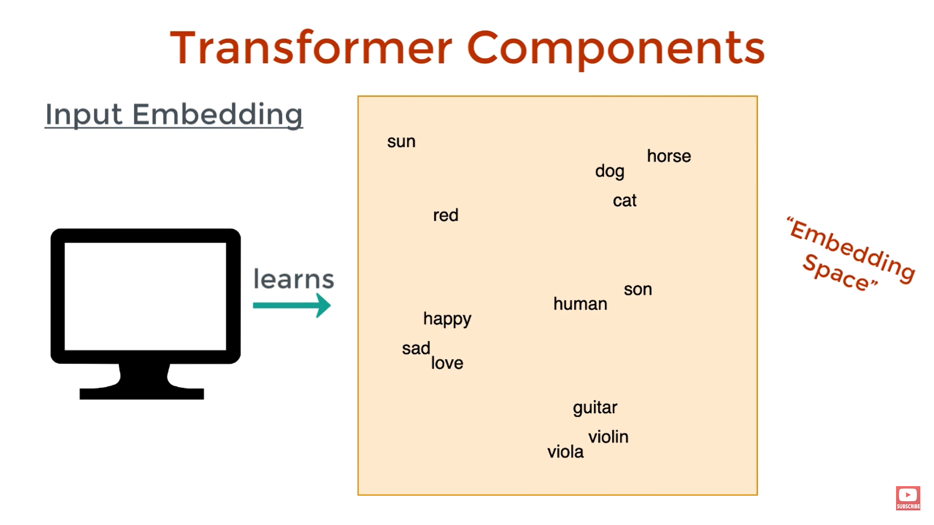

Slide 12
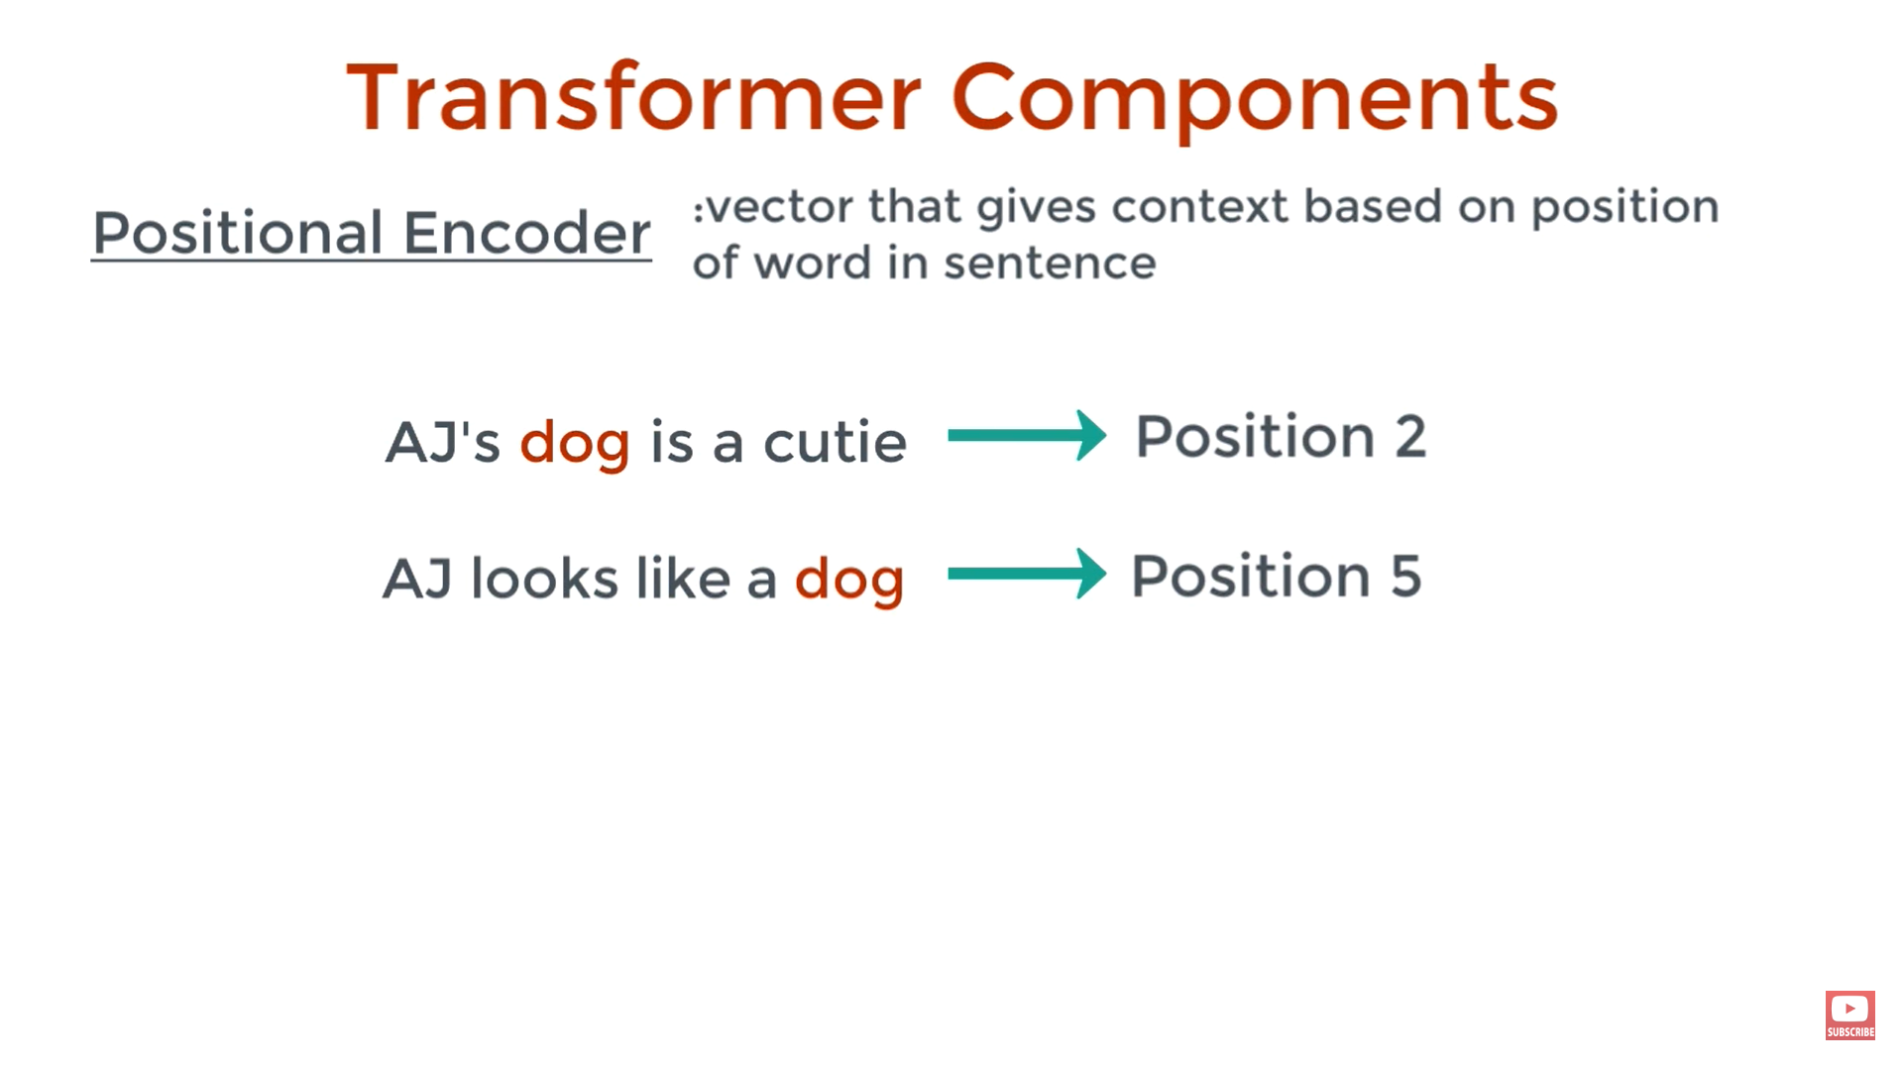

Slide 13
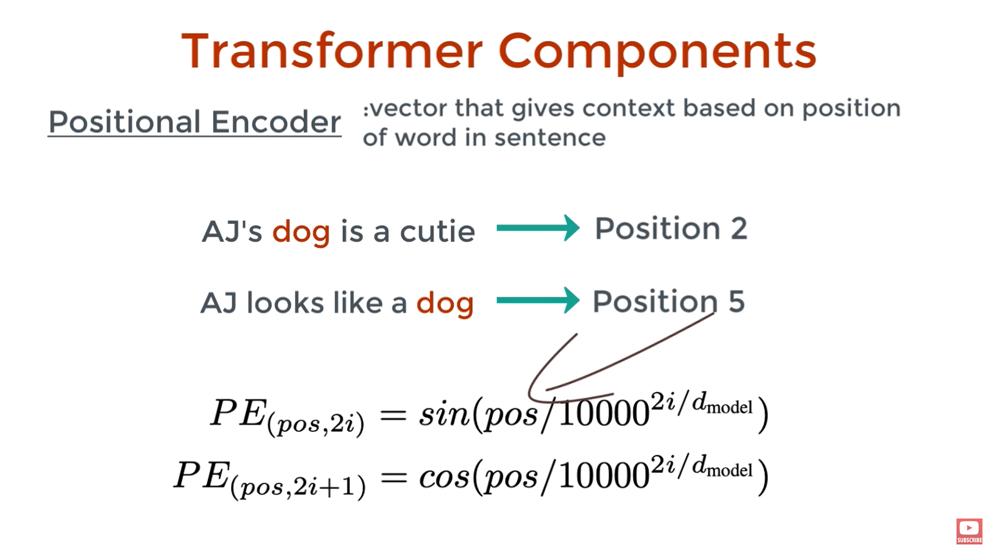

Slide 14
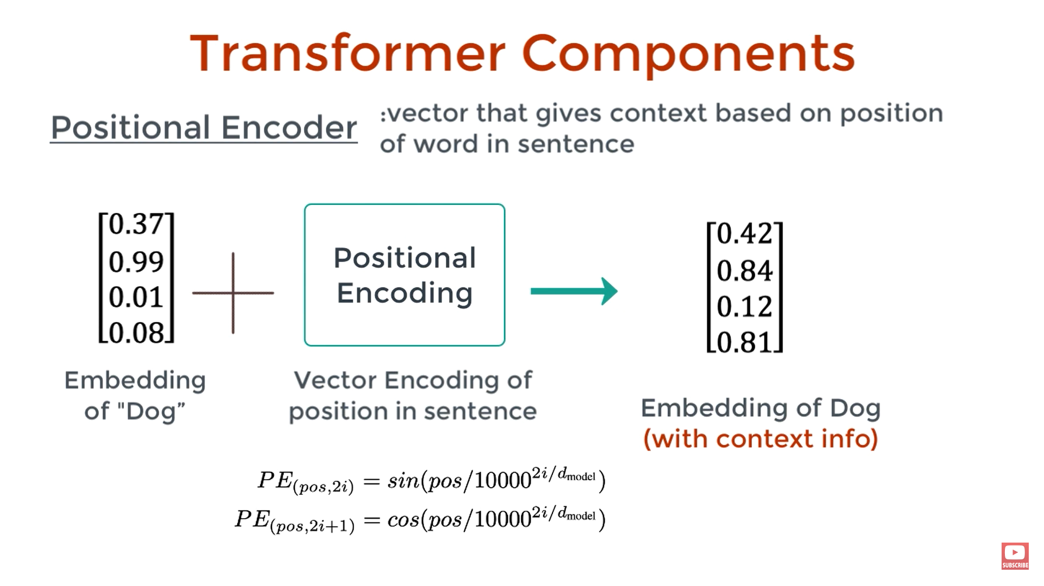
Transformer Explained

Slide 15
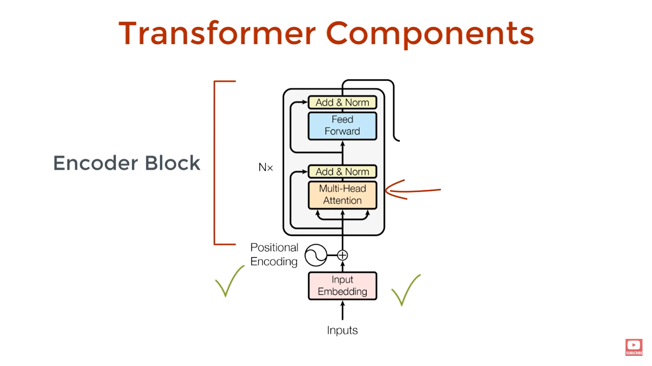
Transformer Explained

Slide 16
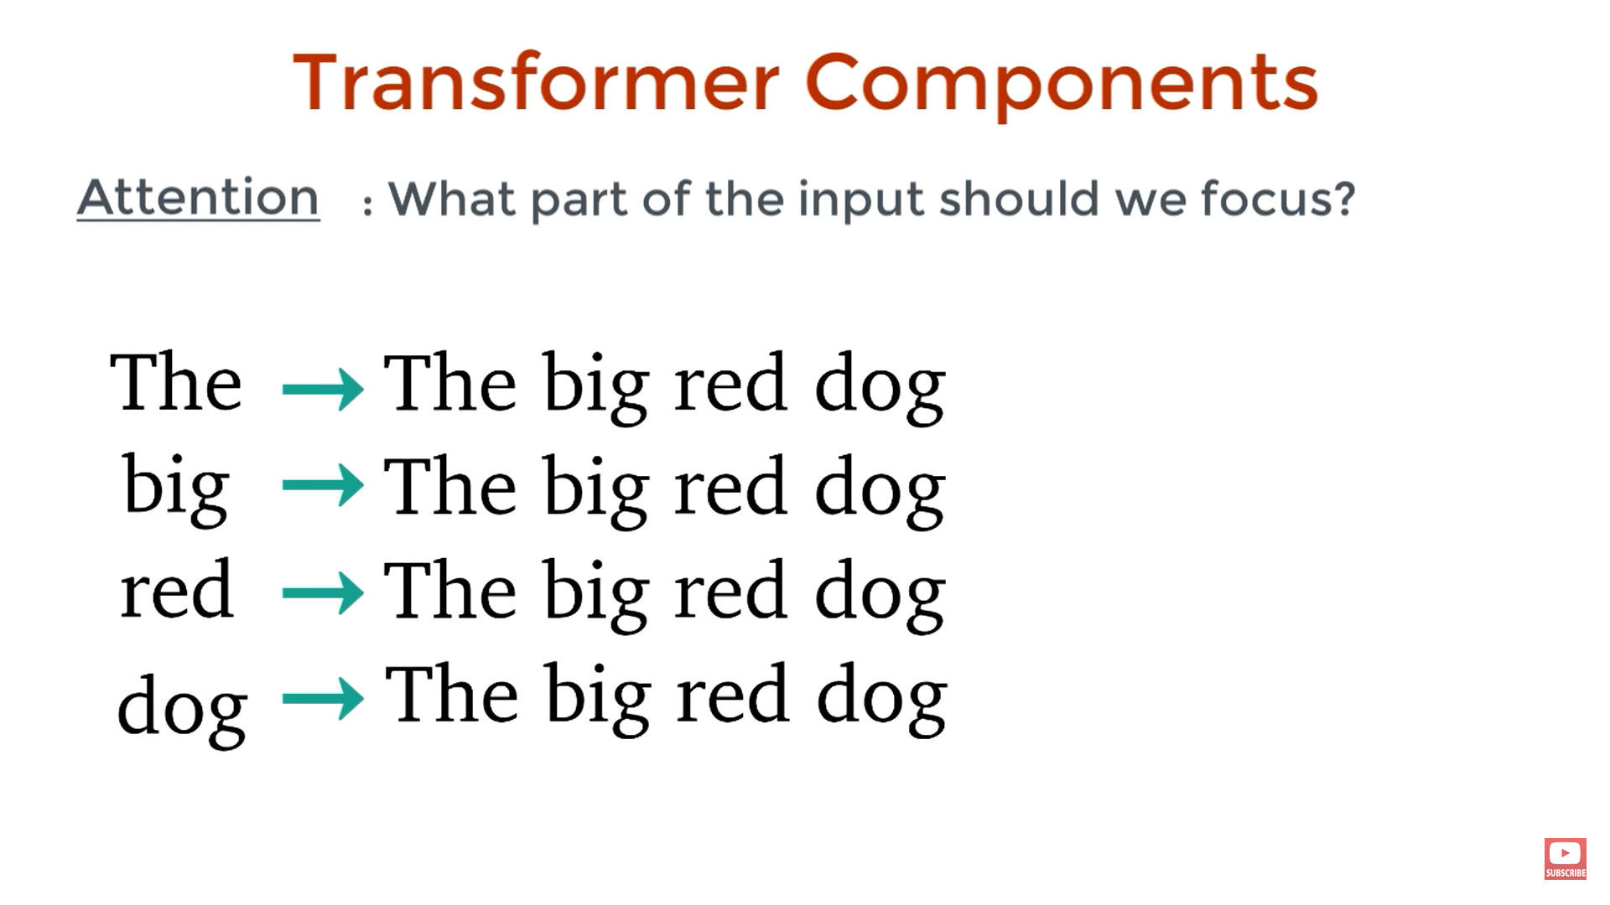
Transformer Explained

Slide 17
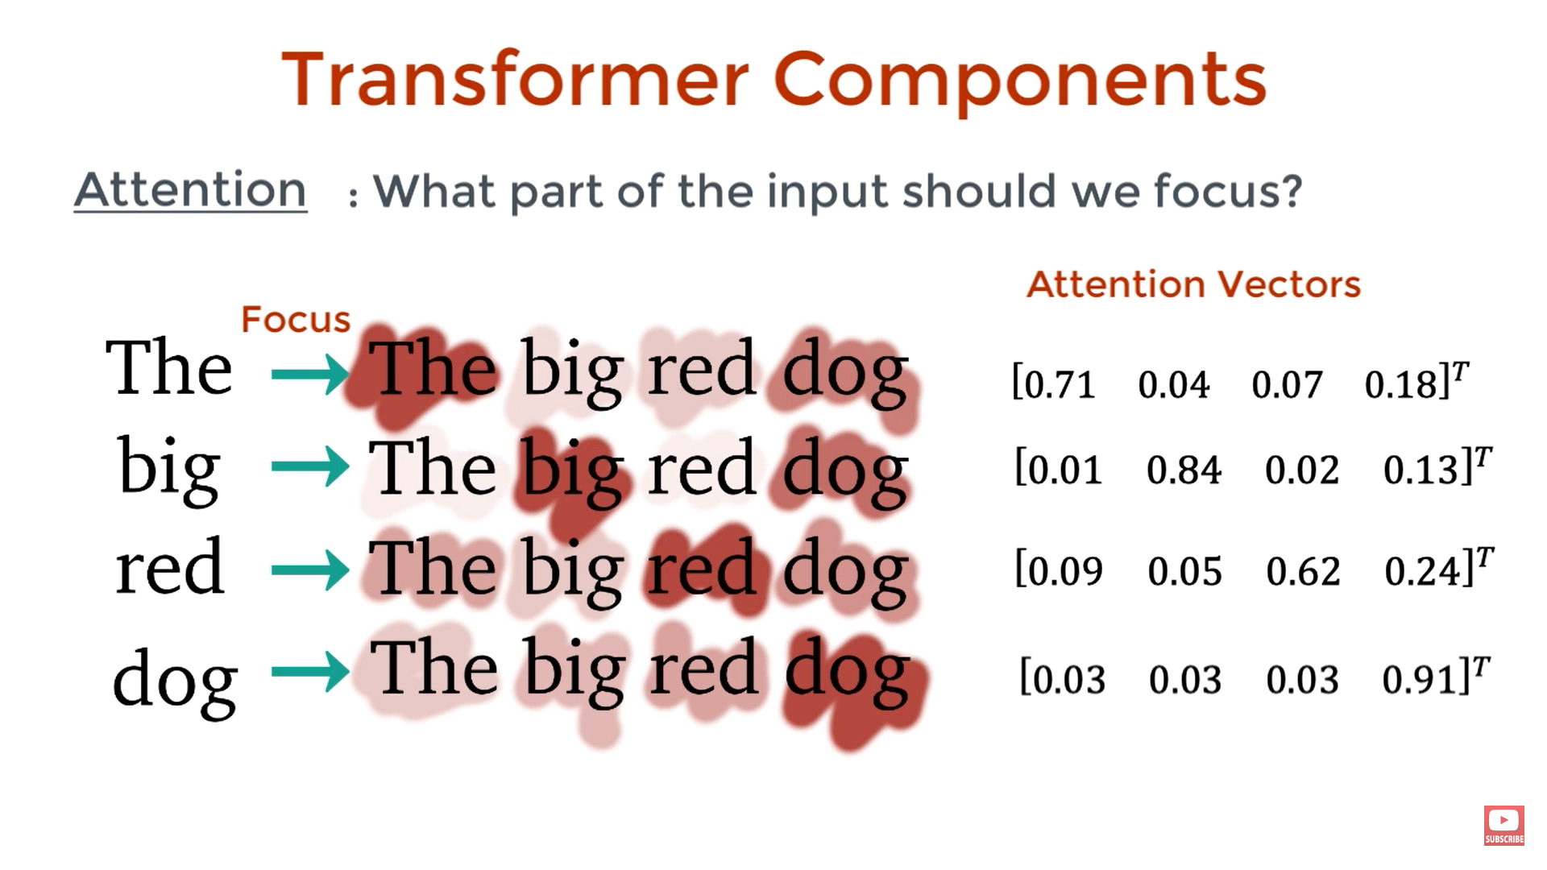
Transformer Explained

Slide 18
Transformer Explained

Slide 19
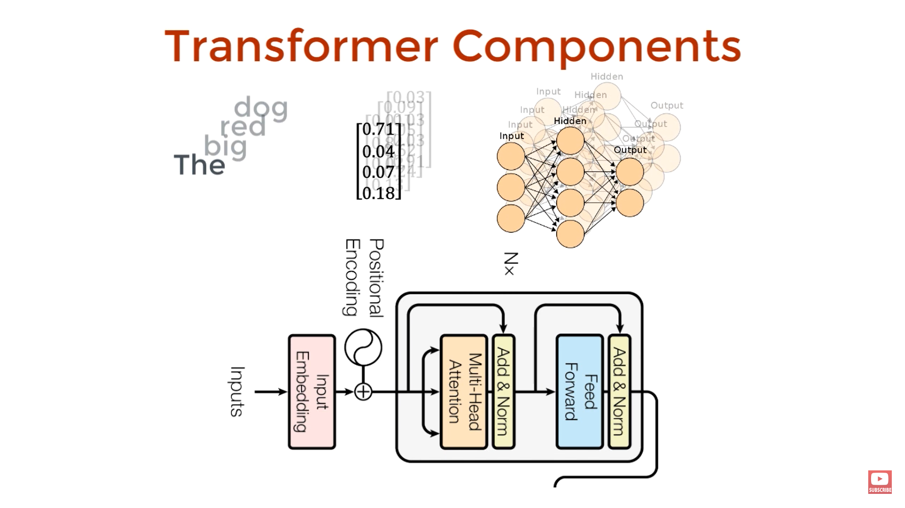
Transformer Explained

Slide 20
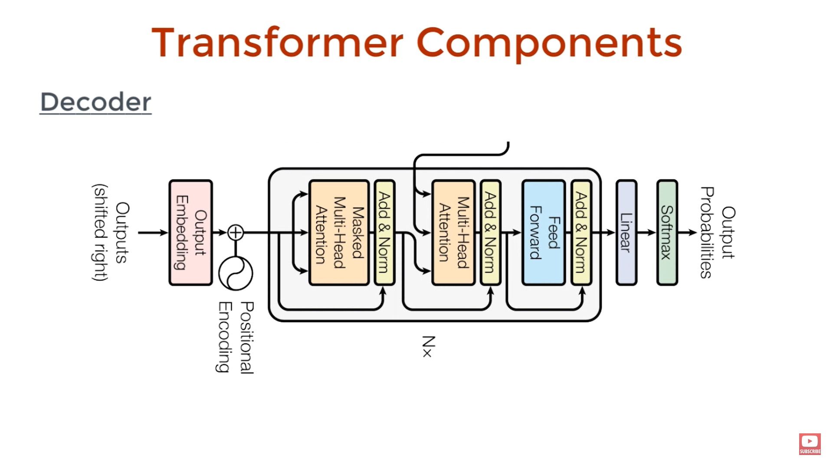
Transformer Explained

Slide 21
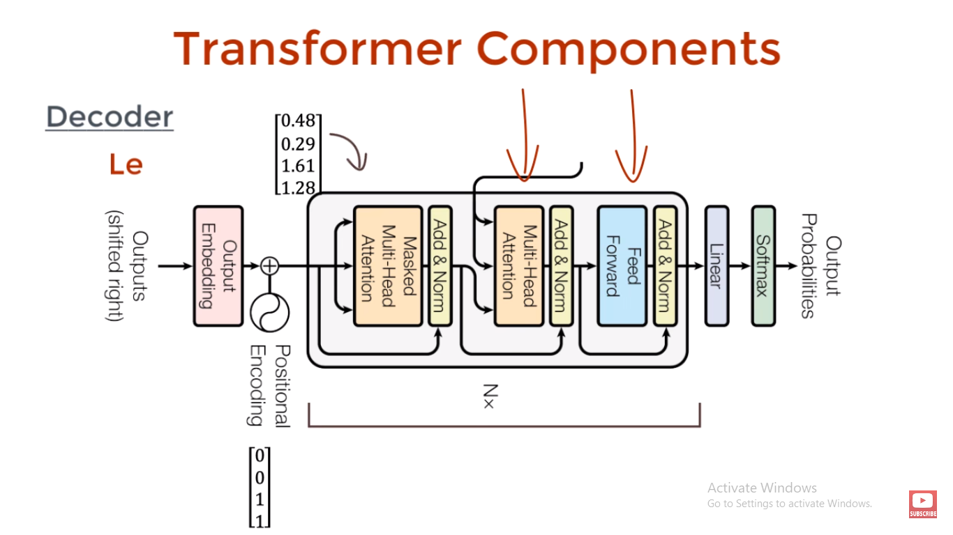
Transformer Explained

Slide 22
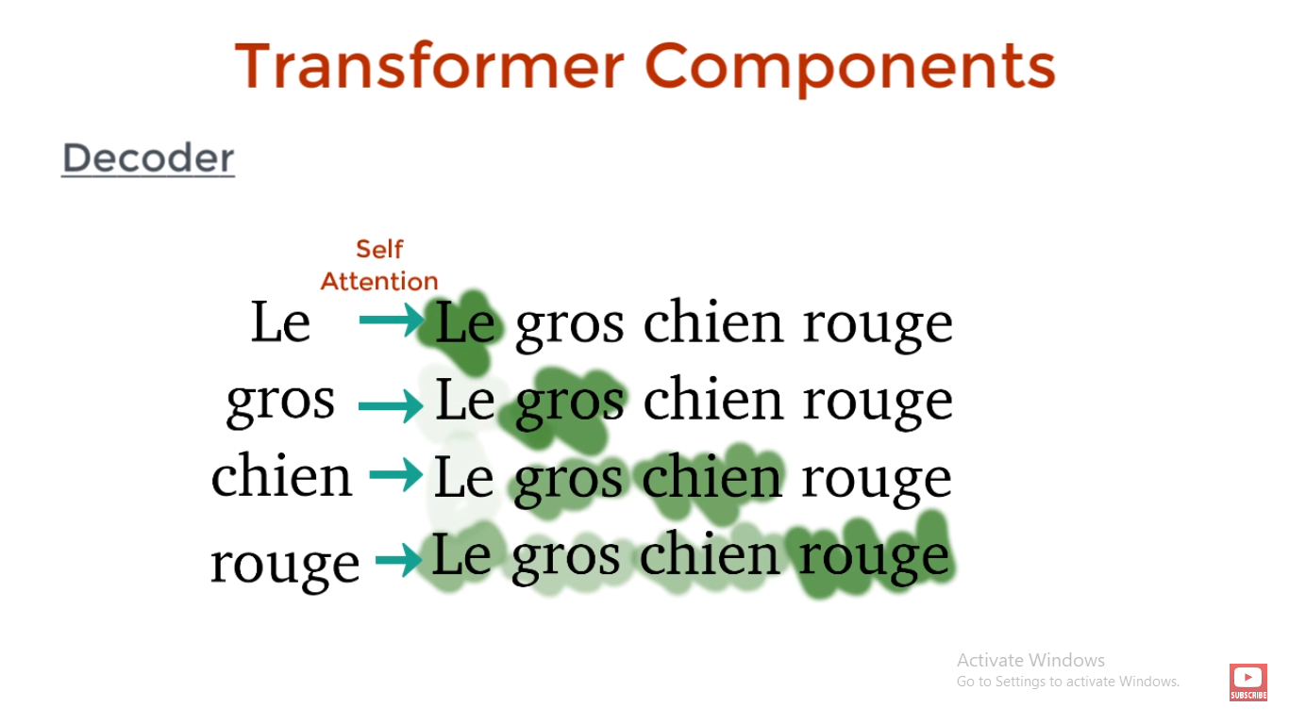
Transformer Explained

Slide 23
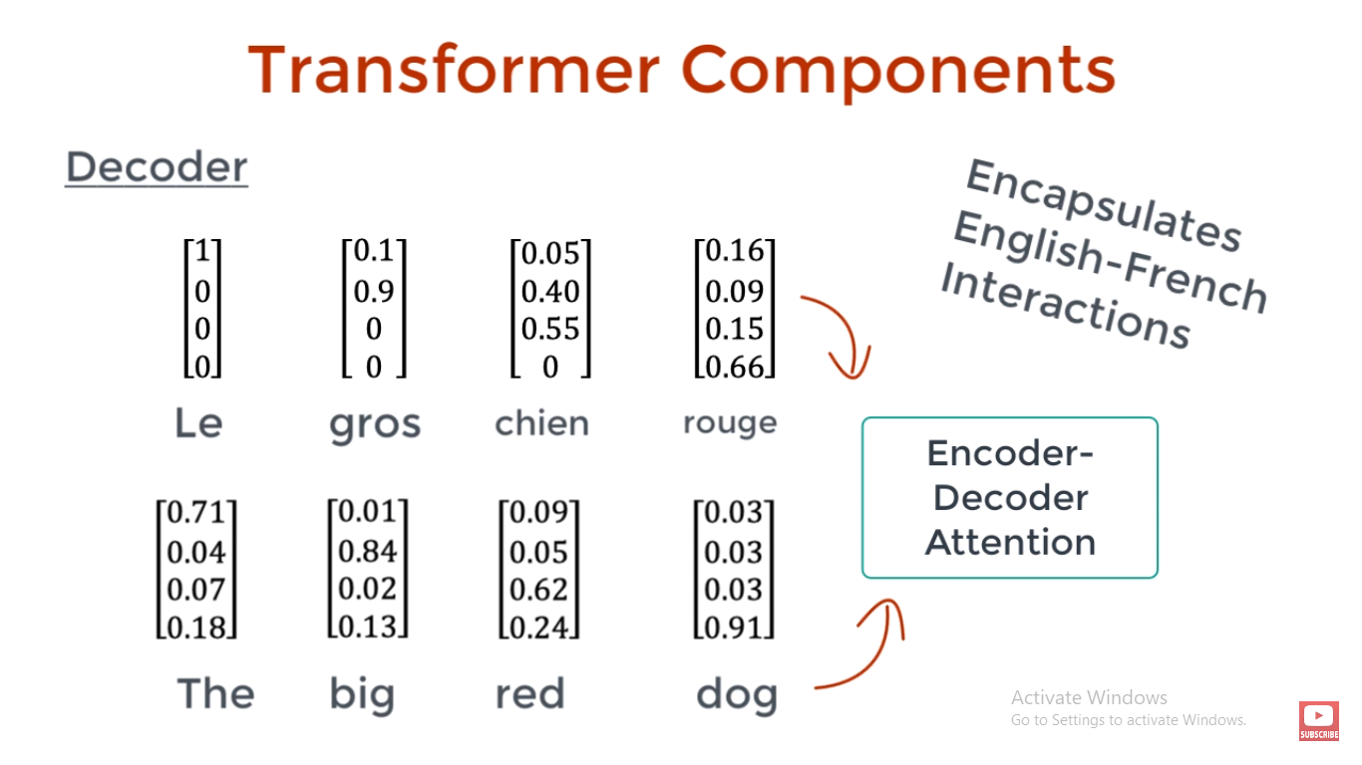
Transformer Explained

Slide 24
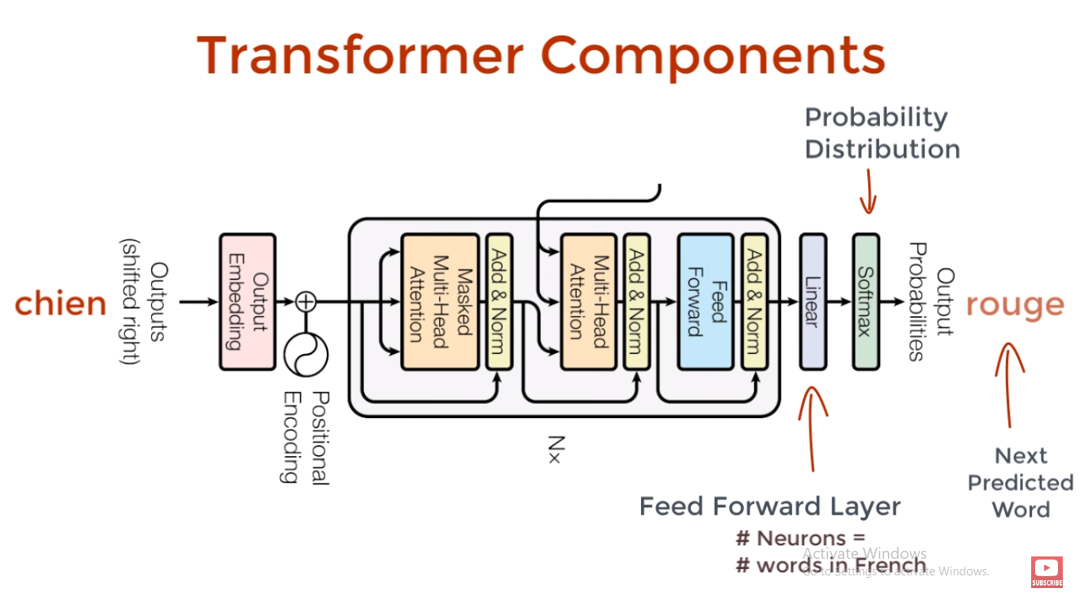
Transformer Explained

Slide 25
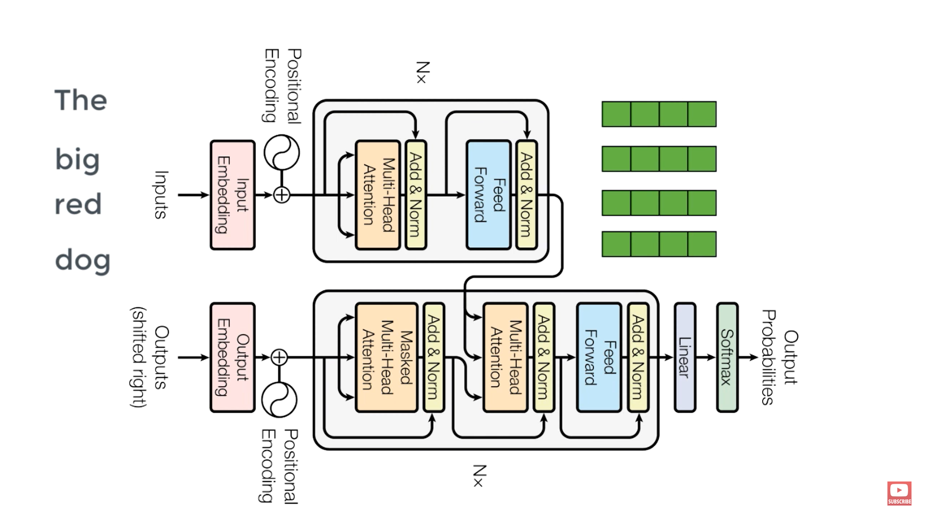
Transformer Explained

Slide 26
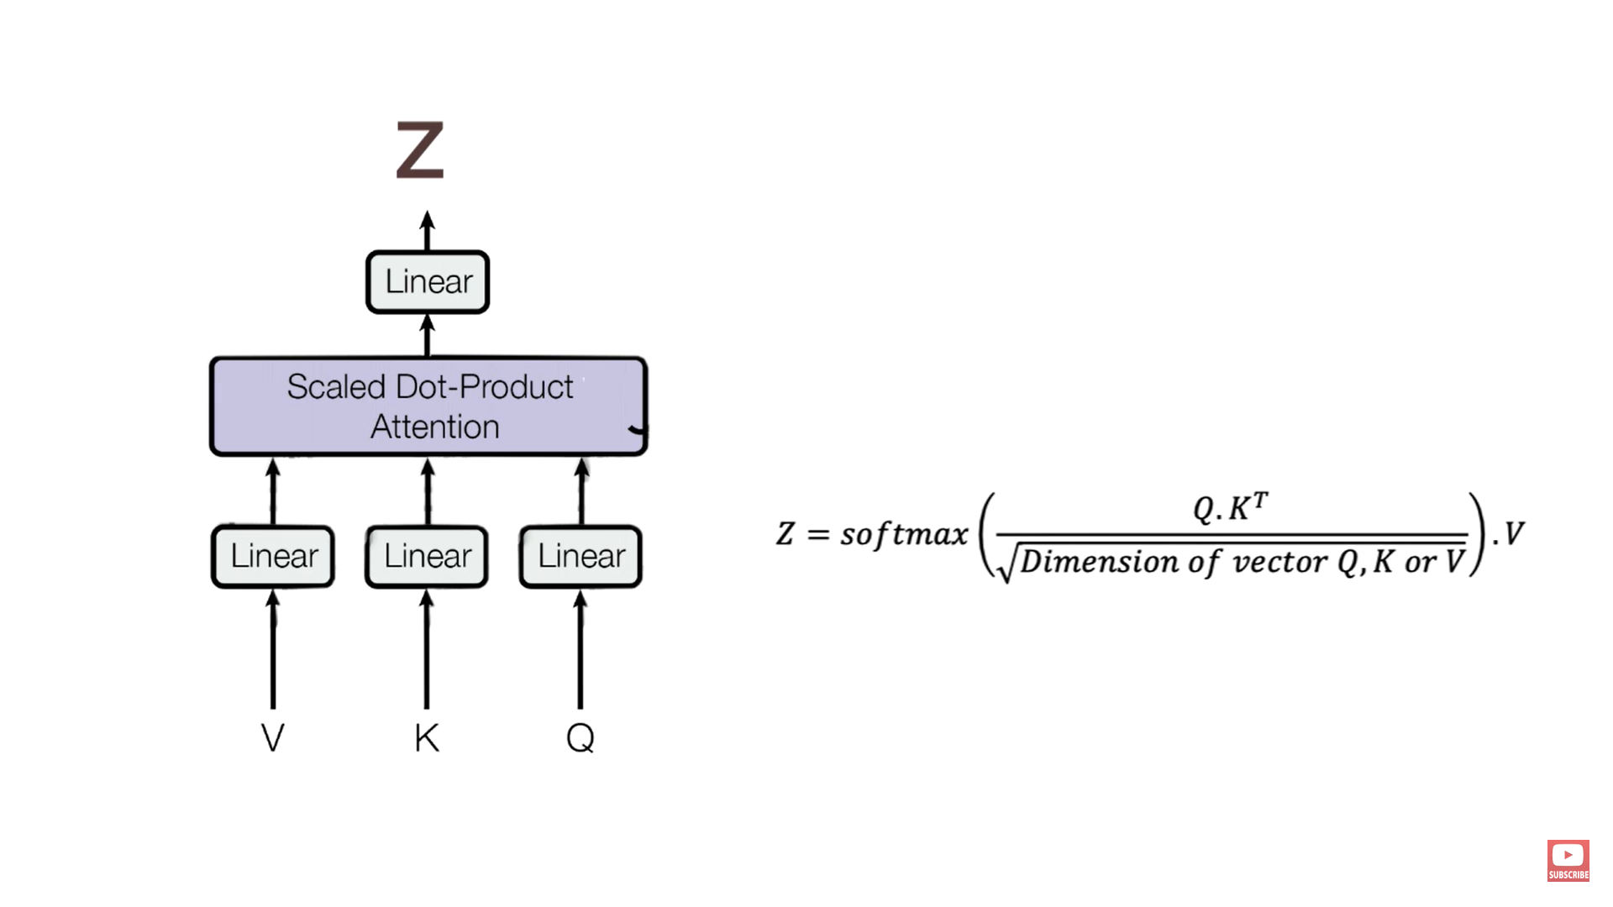
Transformer Explained

Slide 27
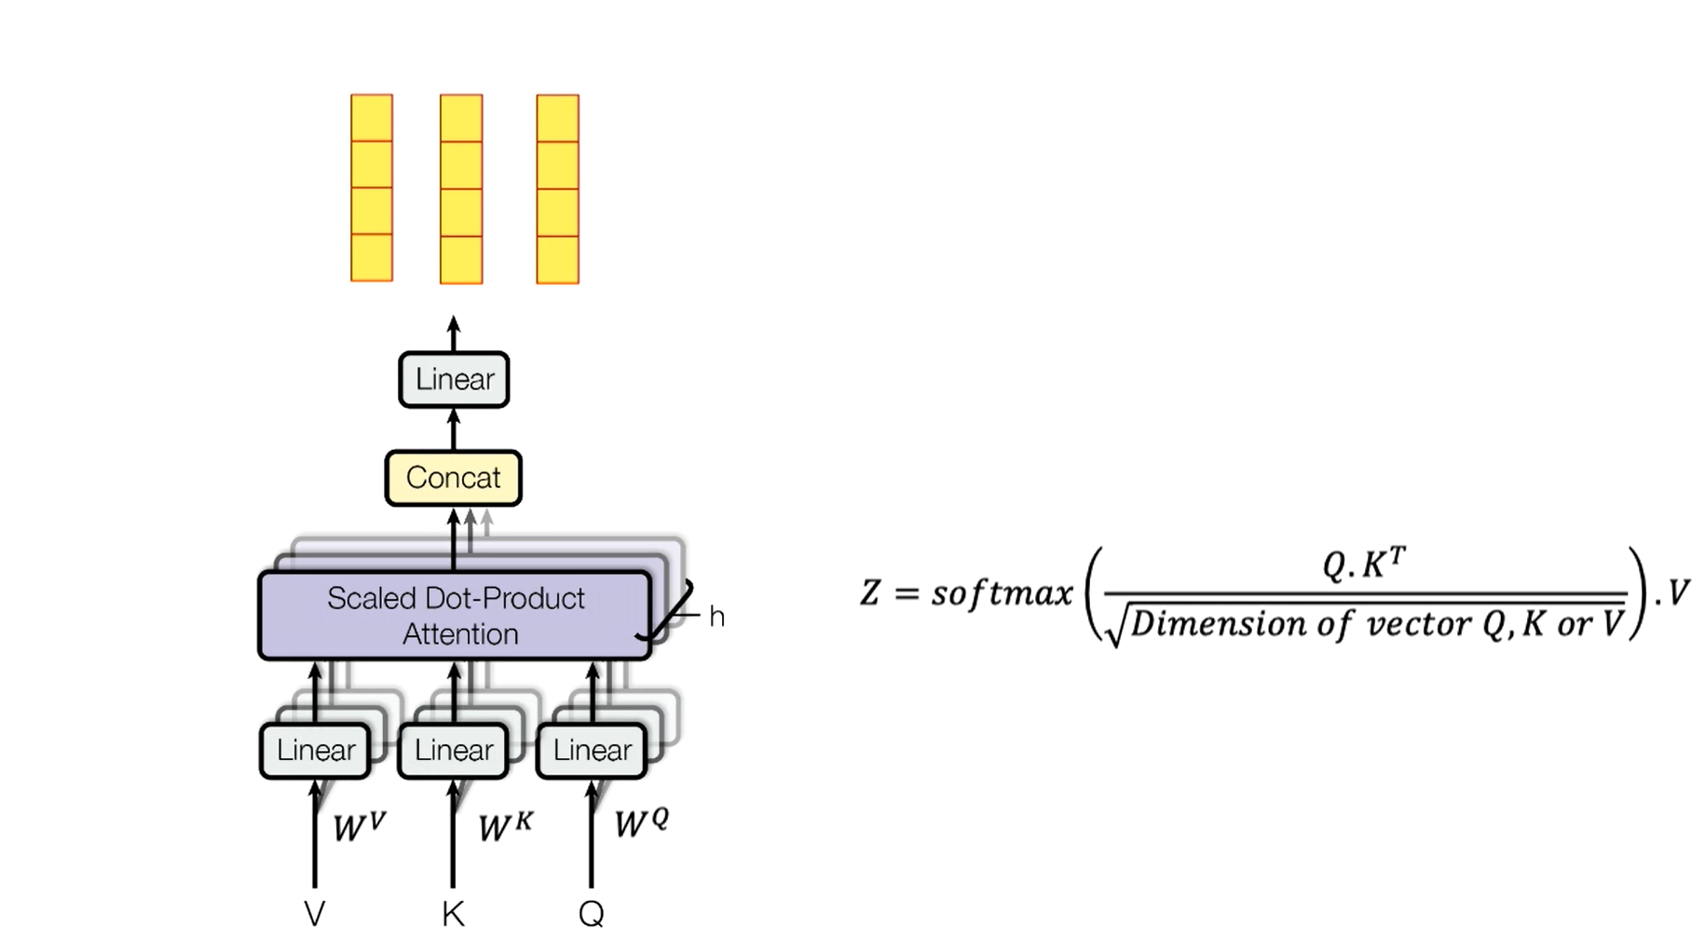
Transformer Explained

Slide 28
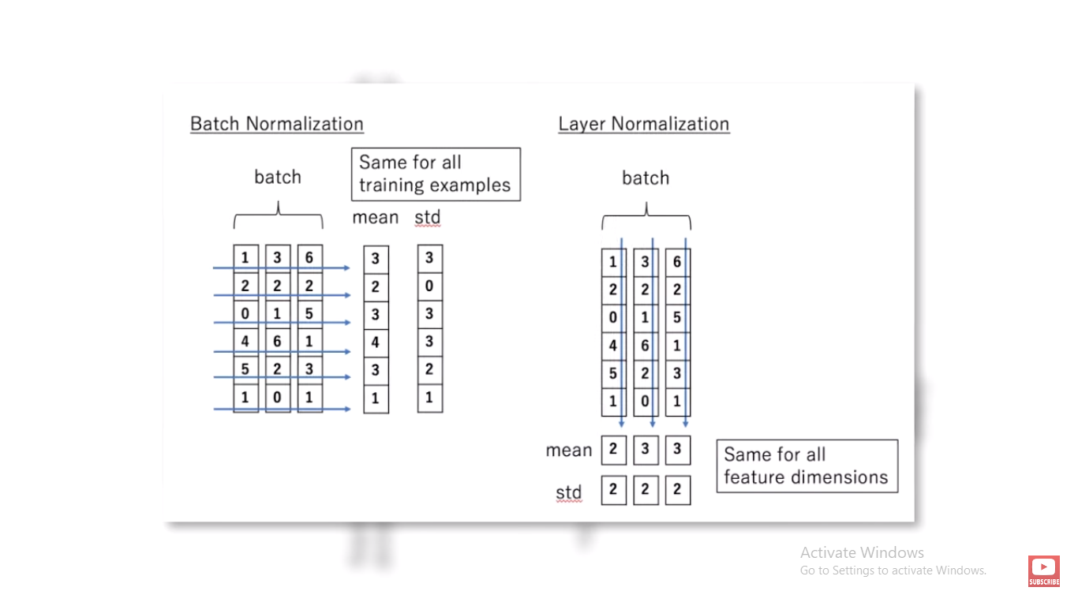
Transformer Explained

Slide 29
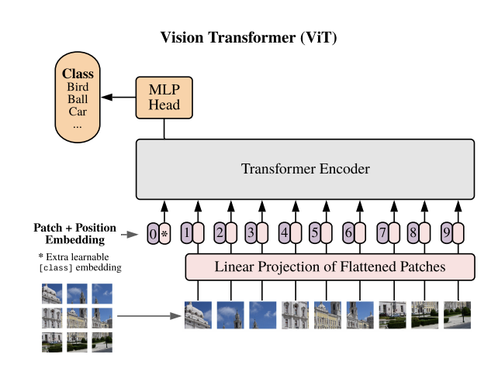

Slide 30
REFERENCE - USEFUL LINKS
The main Paper: https://arxiv.org/abs/1706.03762
Tensor2Tensor has some code with a tutorial: https://www.tensorflow.org/text/tutorials/transformer
Transformer very intuitively explained - Amazing: https://jalammar.github.io/illustrated-transformer/
Medium Blog on intuitive explanation: https://medium.com/inside-machine-learning/what-is-a-transformer-d07dd1fbec04
Pretrained word embeddings: https://nlp.stanford.edu/projects/glove/
Paper that gives even better results than transformers (Pervasive Attention): https://arxiv.org/abs/1808.03867
BERT uses transformers to pretrain neural nets for common NLP tasks. : https://blog.research.google/2018/11/open-sourcing-bert-state-of-art-pre.html
Colah’s Blog: https://colah.github.io/posts/2015-08-Understanding-LSTMs/.
Wiki for timeseries of events: https://en.wikipedia.org/wiki/Transformer_(machine_learning_model

Slide 31


Slide 32
RECTIFIED LINEAR UNIT - RELU
This activation function is non-linear
More powerful & Fast computation
All it does is return zero when the input
value is less than zero and otherwise it
returns the same value that was passed into it.

Slide 33
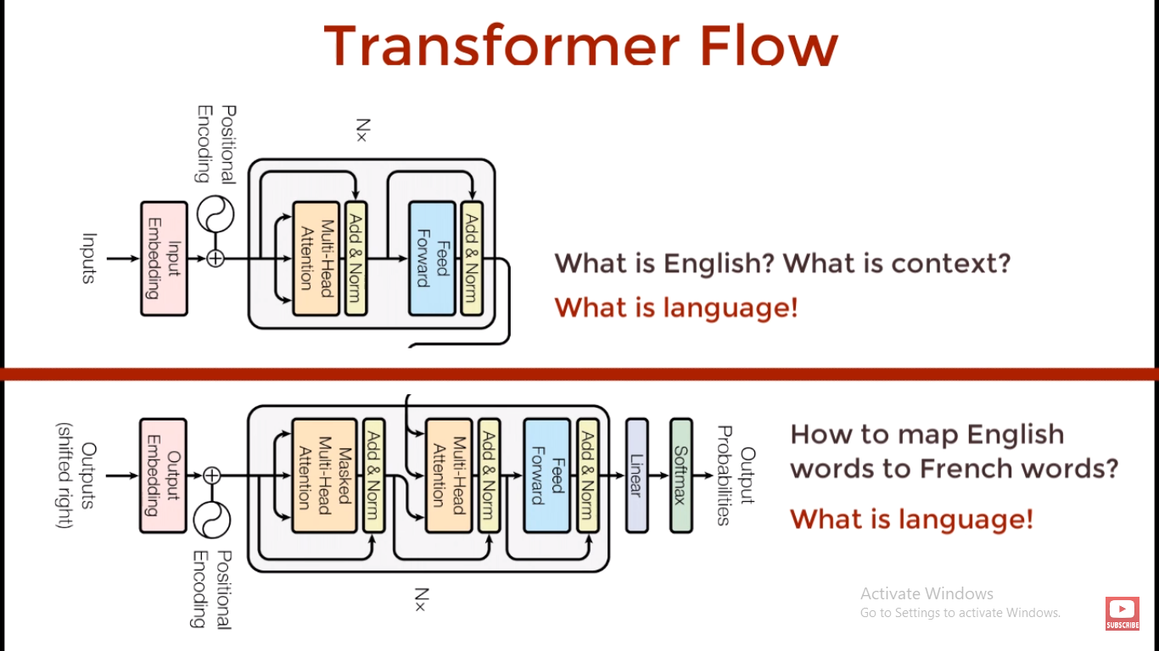

Slide 34
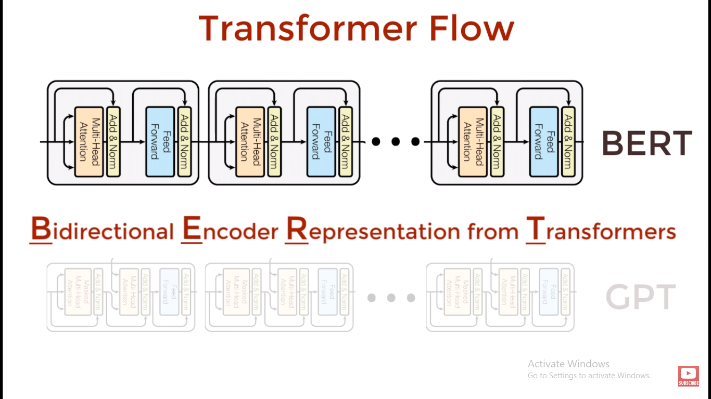

Slide 35
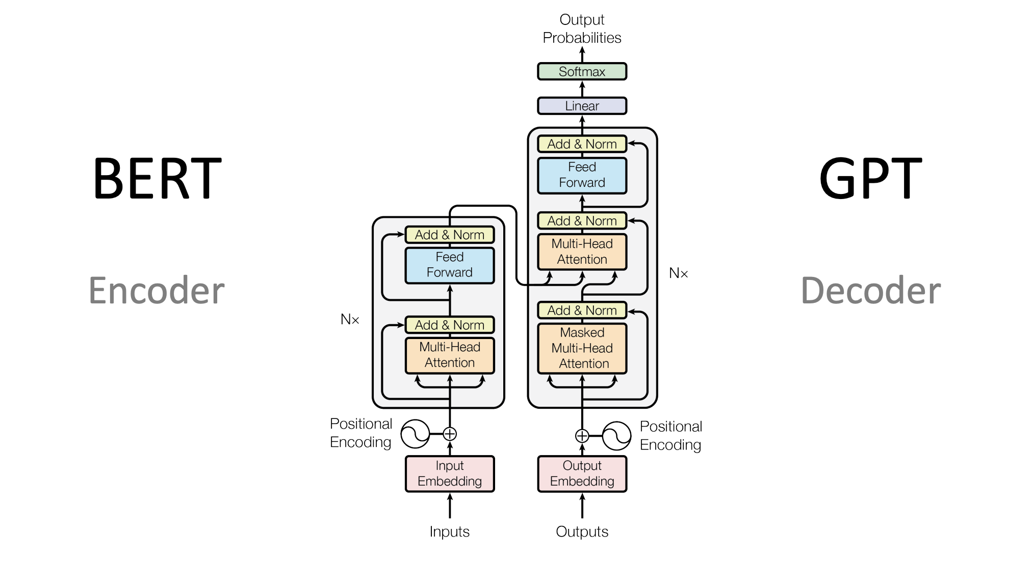

Slide 36
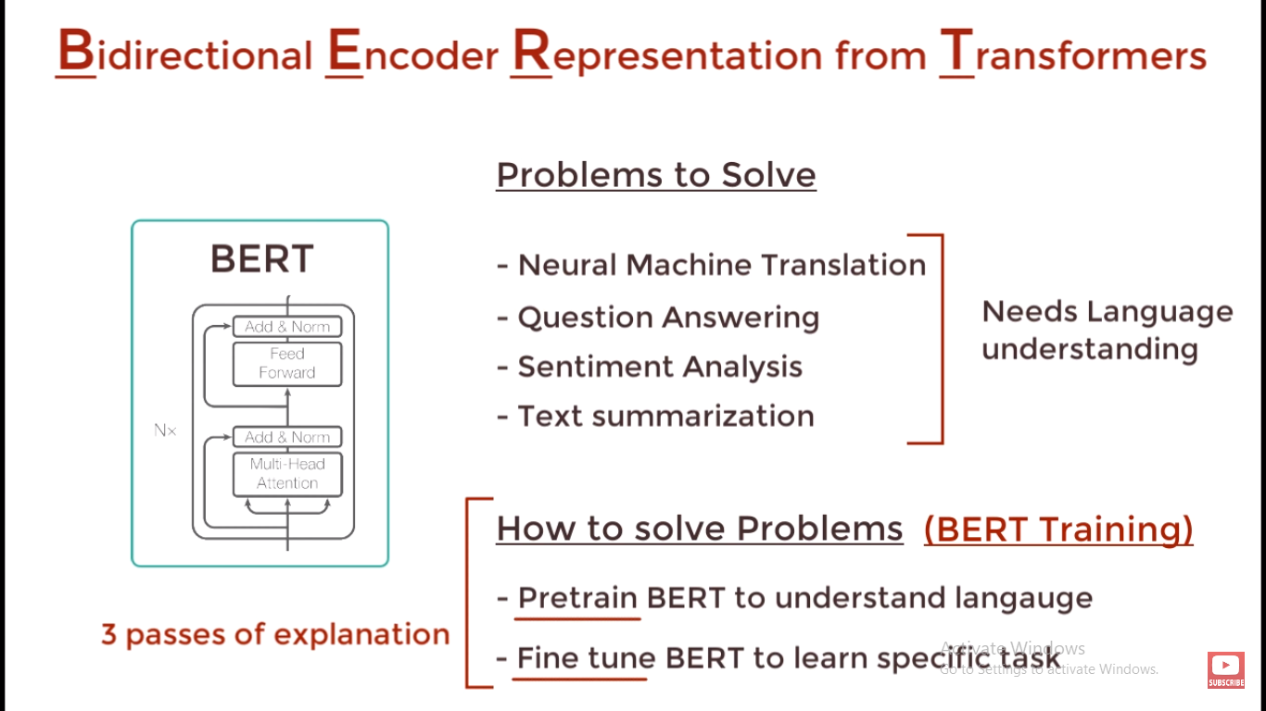

Slide 37
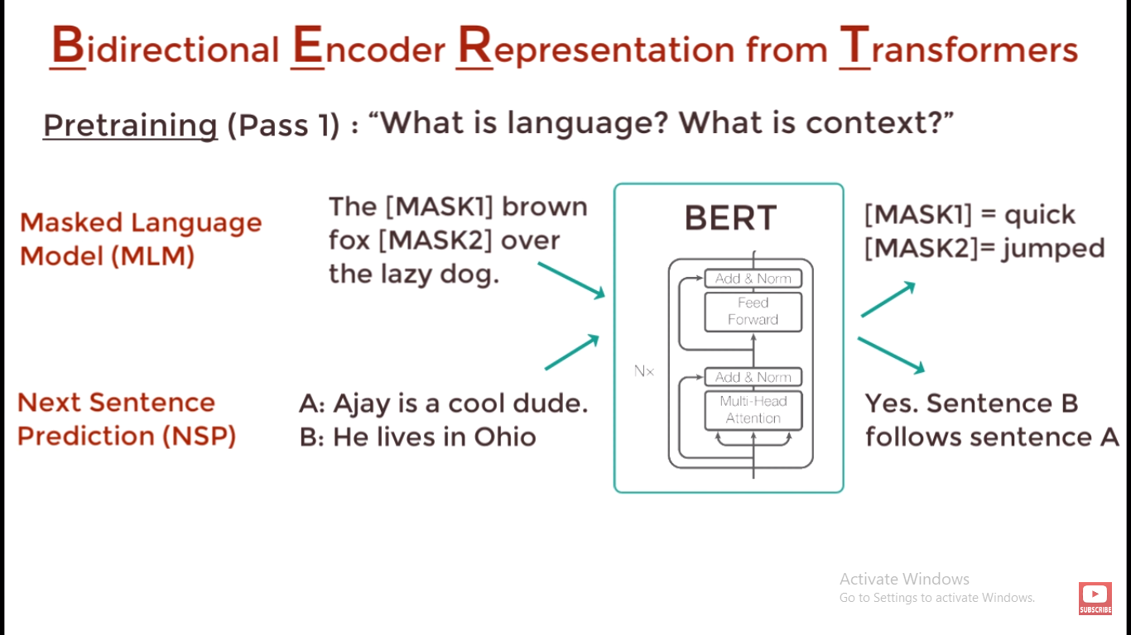
COST OR LOSS FUNCTION
Used to calculate how wrong our predictions model is.
loss function = [(actual value) – (predicted vallue)]^2

Slide 38
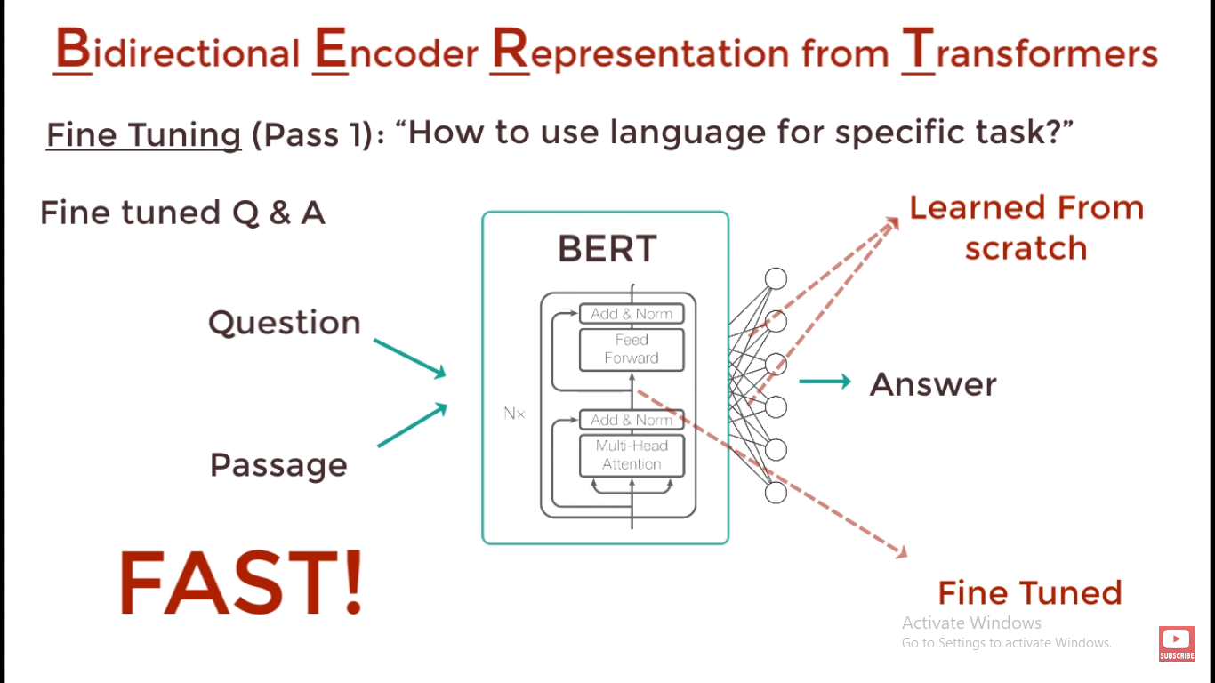
COST OR LOSS FUNCTION
Used to calculate how wrong our predictions model is.
loss function = [(actual value) – (predicted vallue)]^2

Slide 39
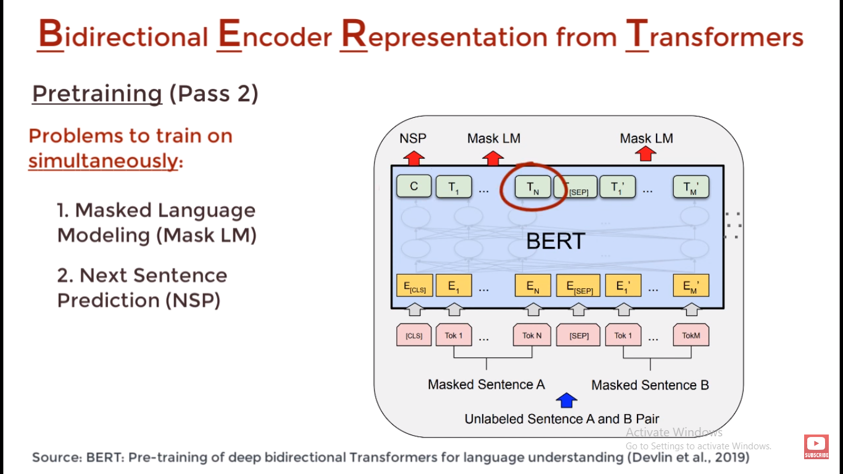
COST OR LOSS FUNCTION
Used to calculate how wrong our predictions model is.
loss function = [(actual value) – (predicted vallue)]^2

Slide 40
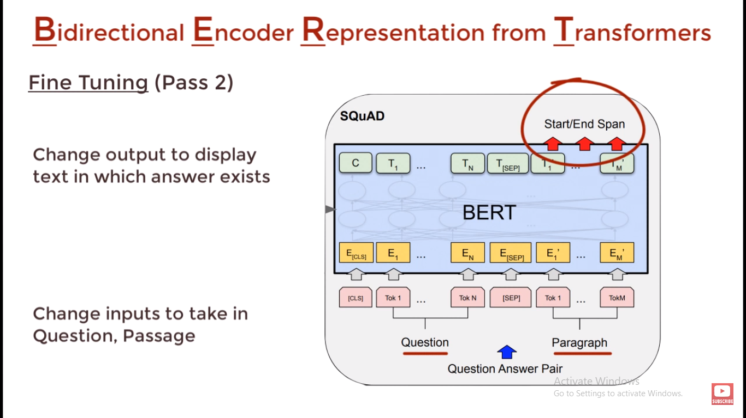
COST OR LOSS FUNCTION
Used to calculate how wrong our predictions model is.
loss function = [(actual value) – (predicted vallue)]^2

Slide 41
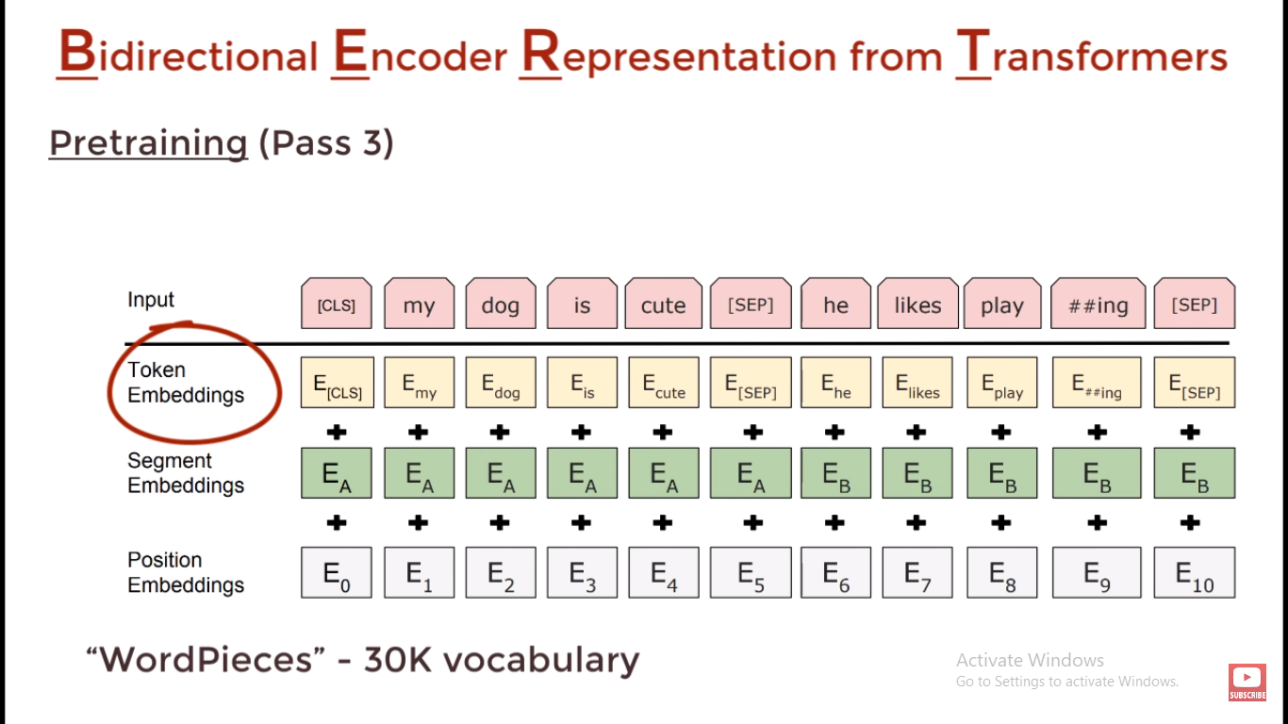
COST OR LOSS FUNCTION
Used to calculate how wrong our predictions model is.
loss function = [(actual value) – (predicted vallue)]^2

Slide 42
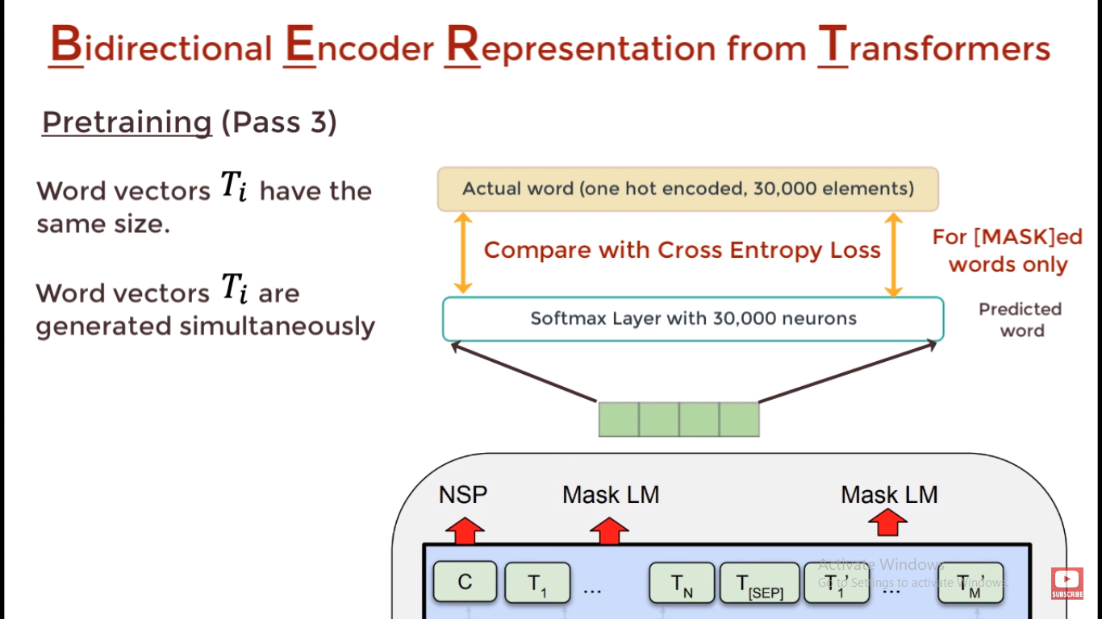
COST OR LOSS FUNCTION
Used to calculate how wrong our predictions model is.
loss function = [(actual value) – (predicted vallue)]^2

Slide 43
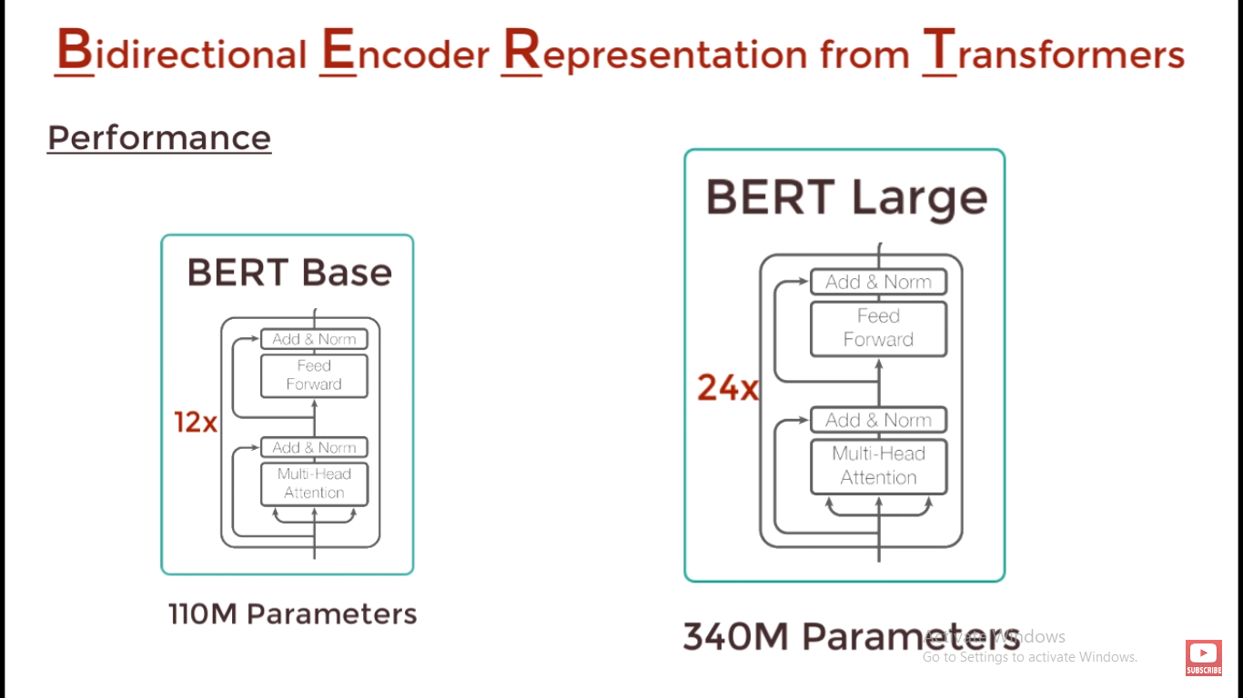
COST OR LOSS FUNCTION
Used to calculate how wrong our predictions model is.
loss function = [(actual value) – (predicted vallue)]^2

Slide 44

GPT
GENERATIVE PRE-TRAINED TRANSFORMER

Slide 45
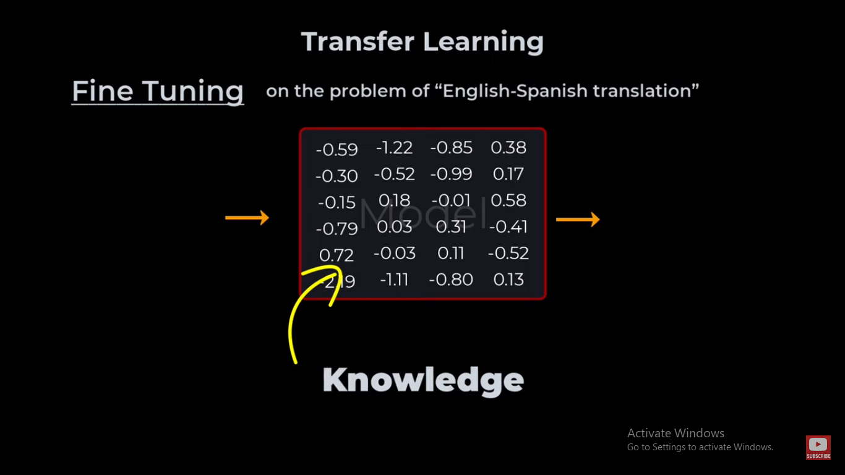

Slide 46
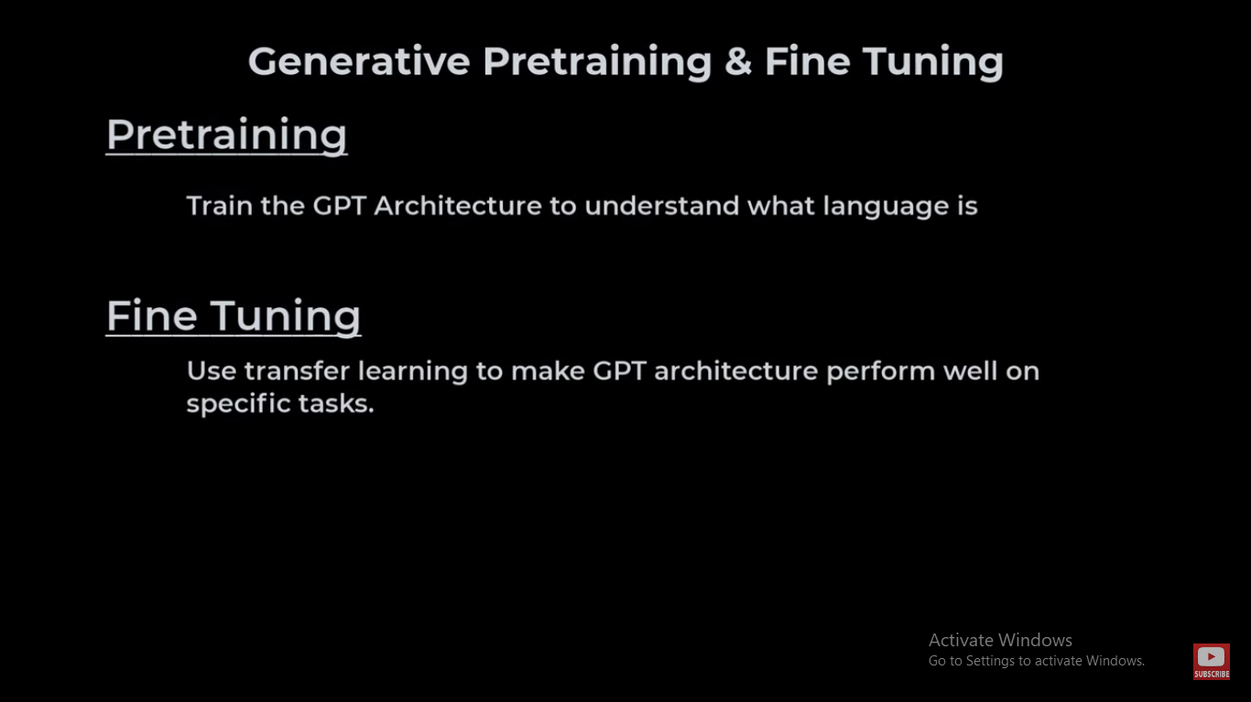

Slide 47
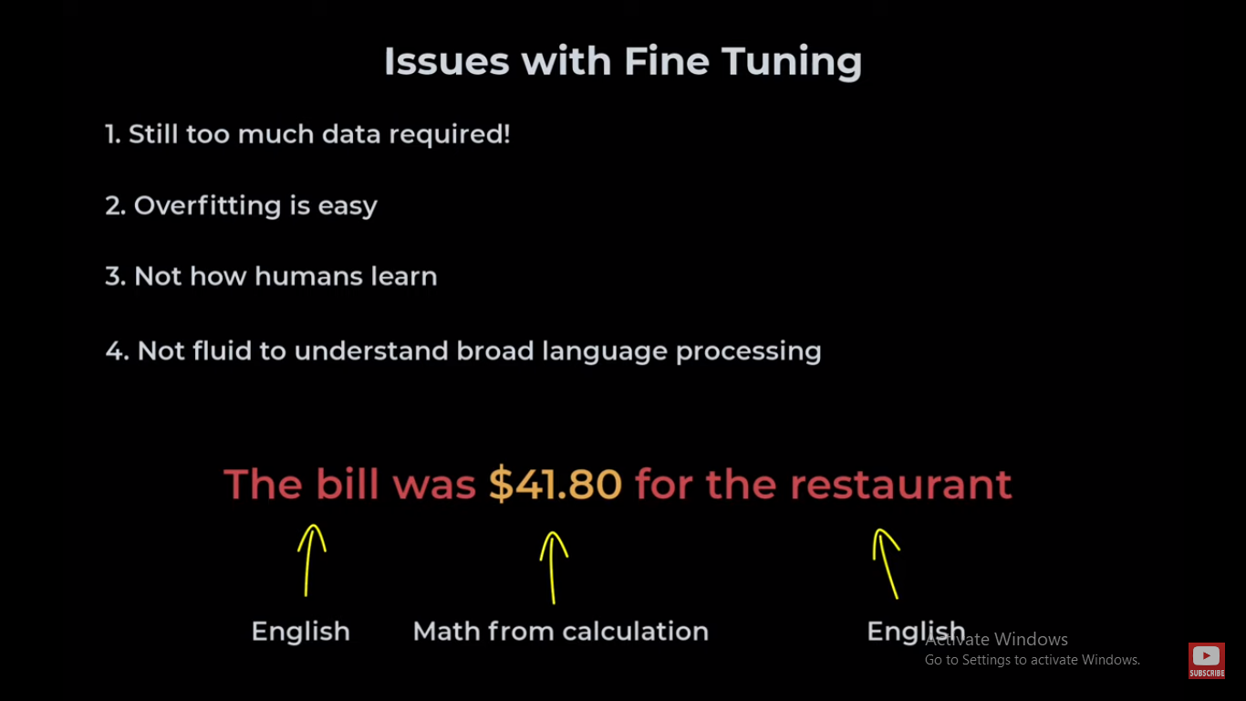

Slide 48
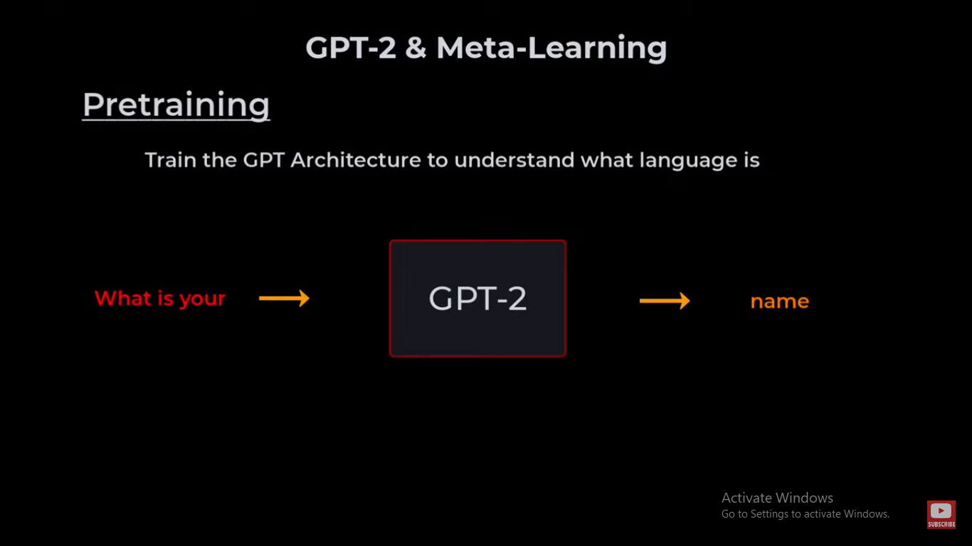

Slide 49
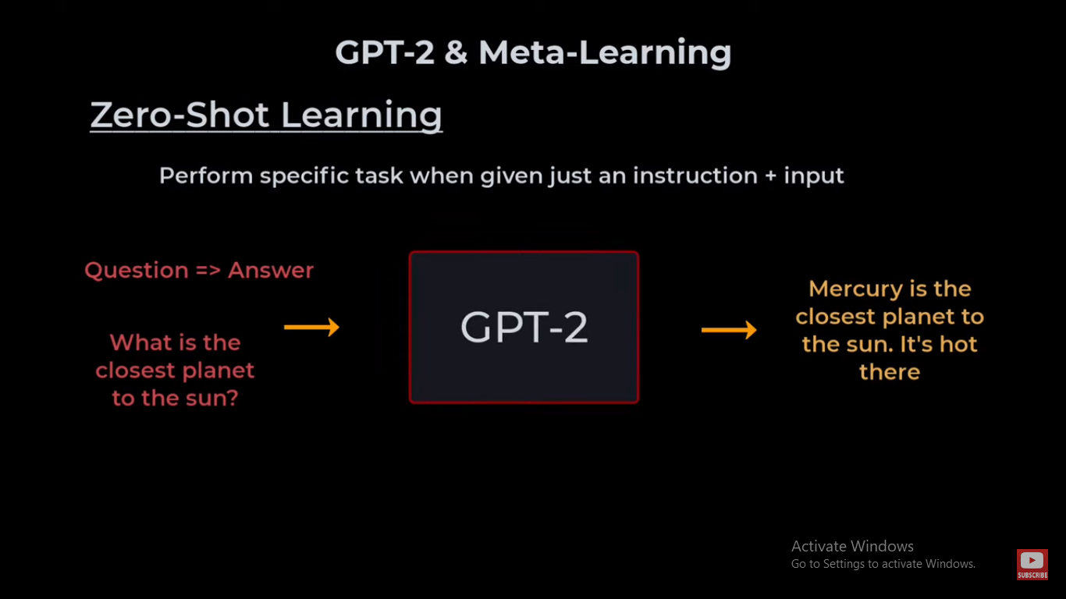

Slide 50
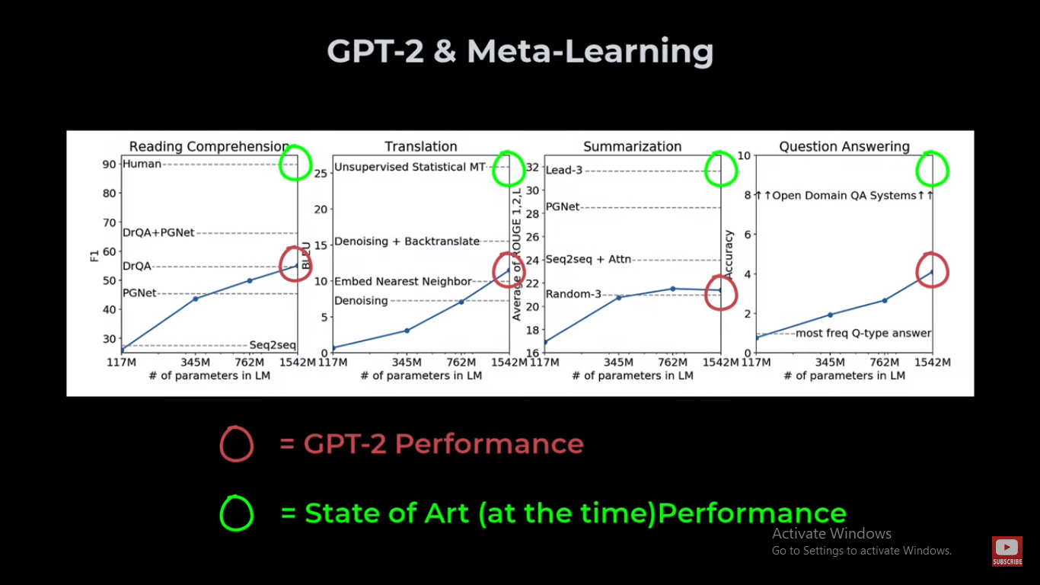

Slide 51
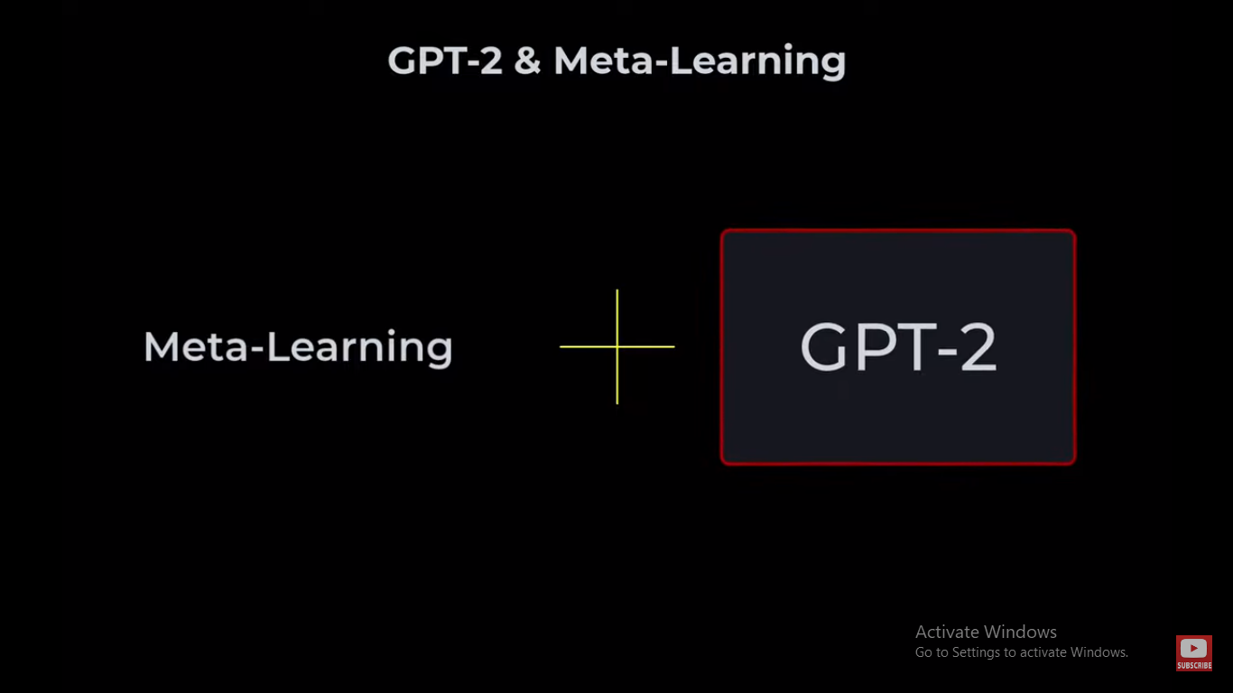

Slide 52
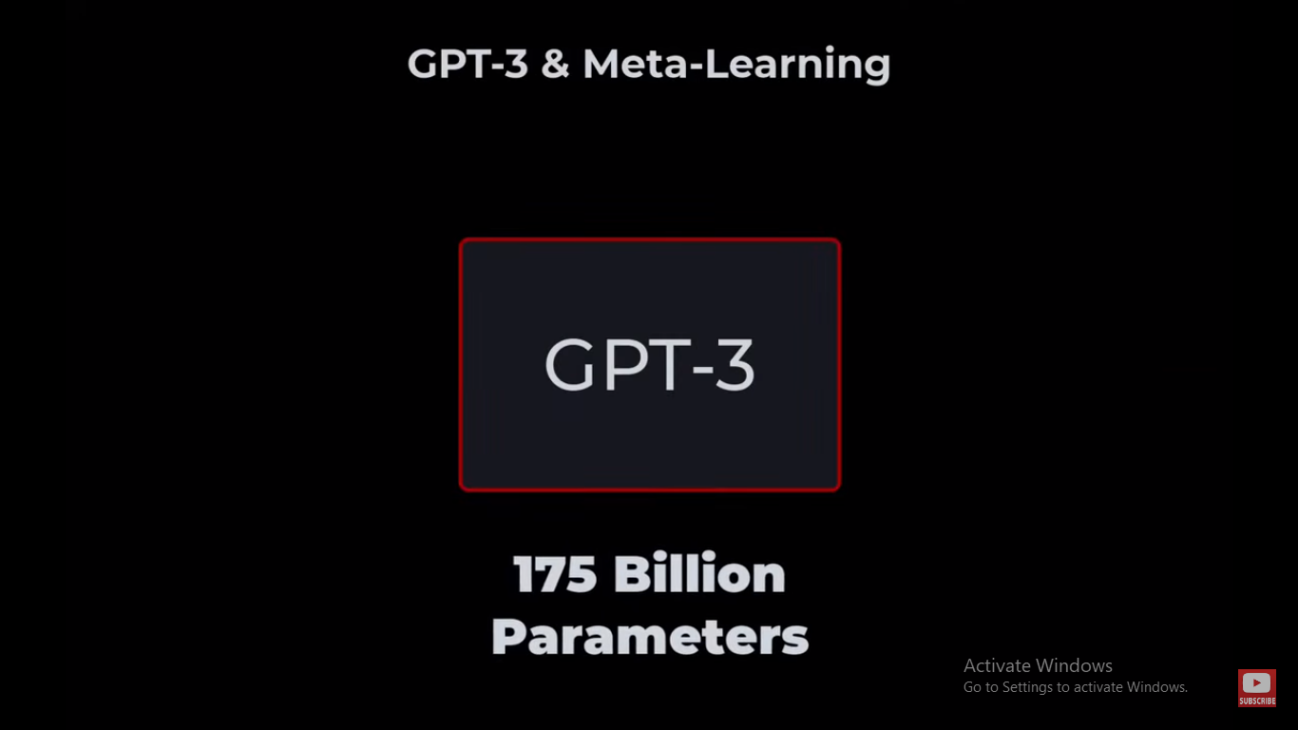

Slide 53
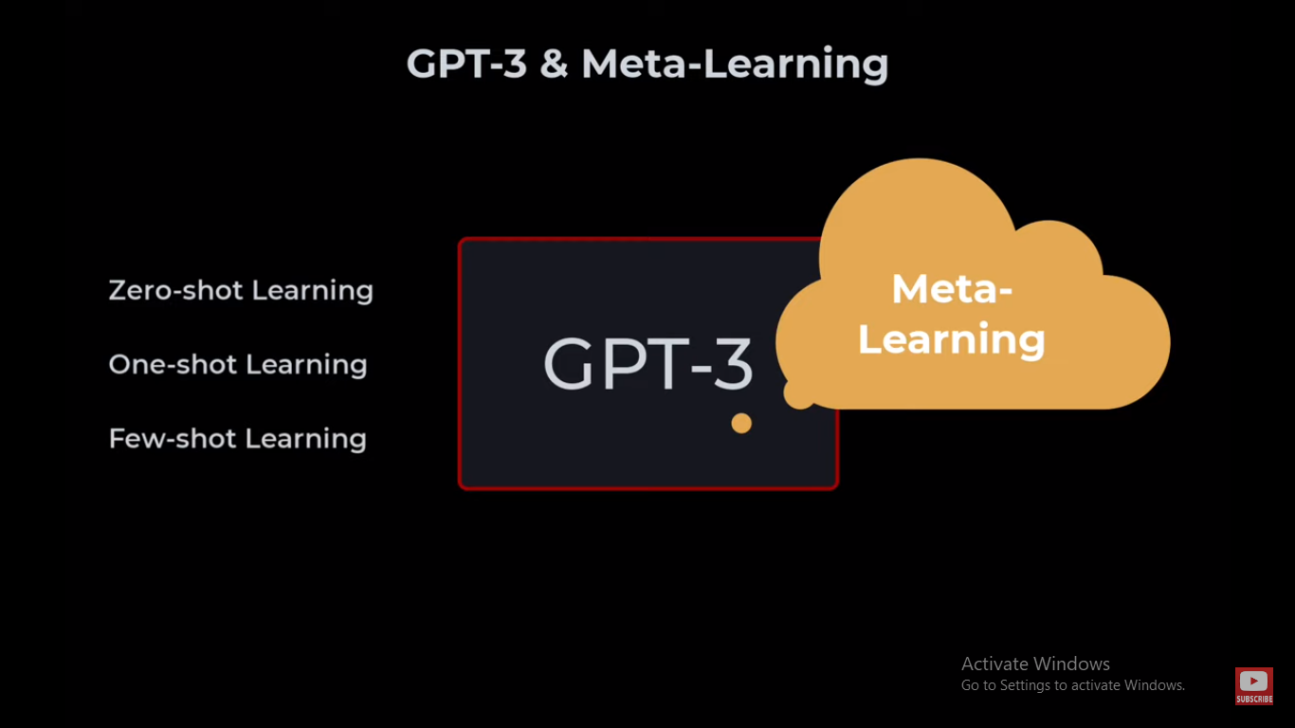

Slide 54
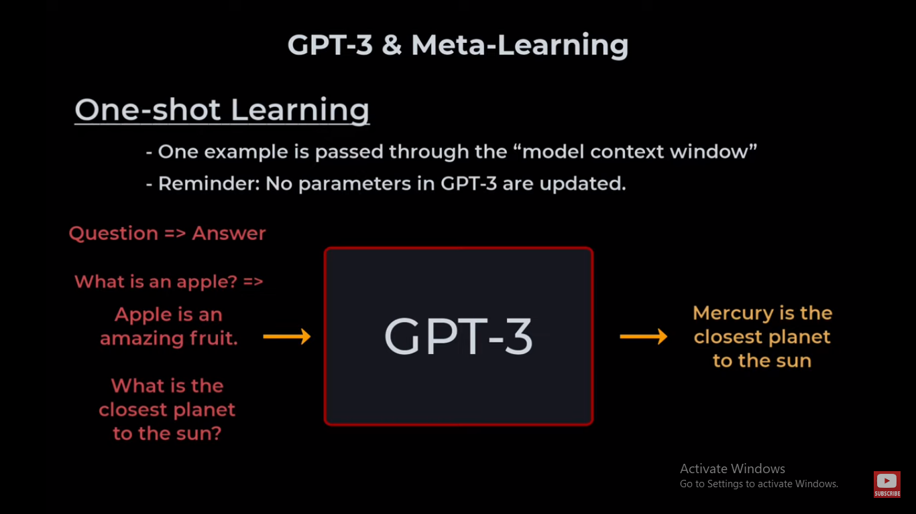
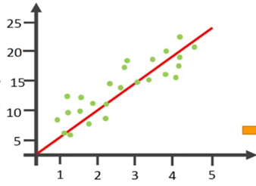
WHAT IS LINEAR REGRESSION ?

Slide 55
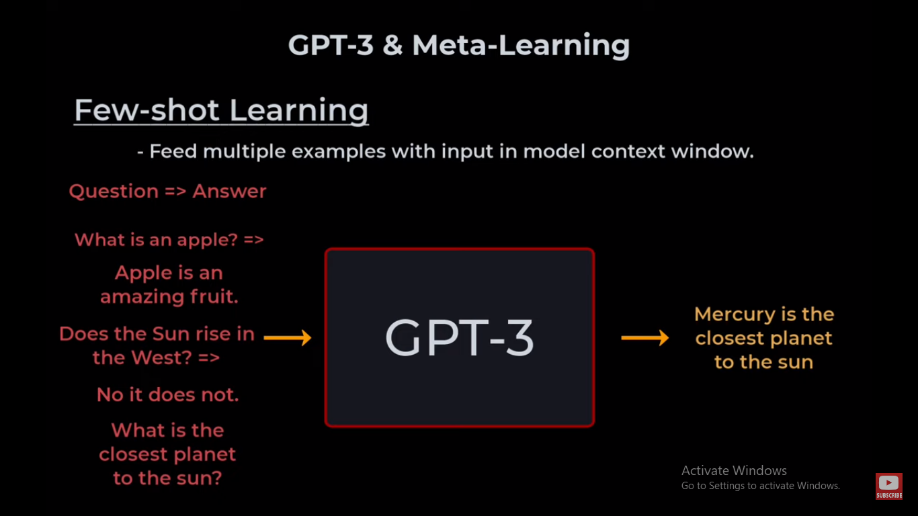
LINEAR REGRESSION WITH SINGLE NEURON

Slide 56
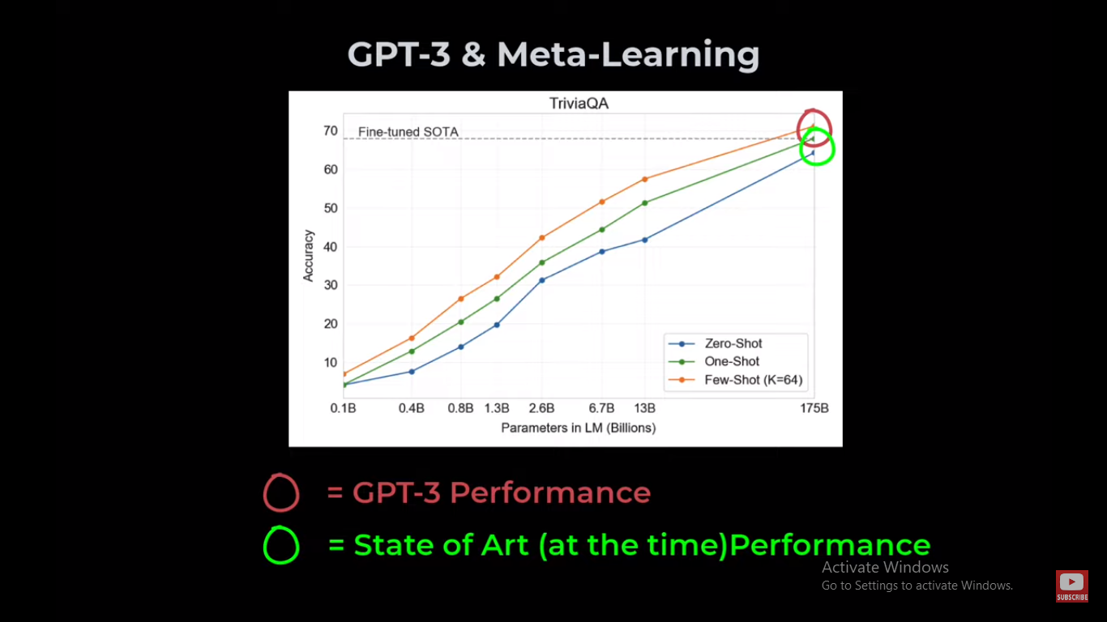
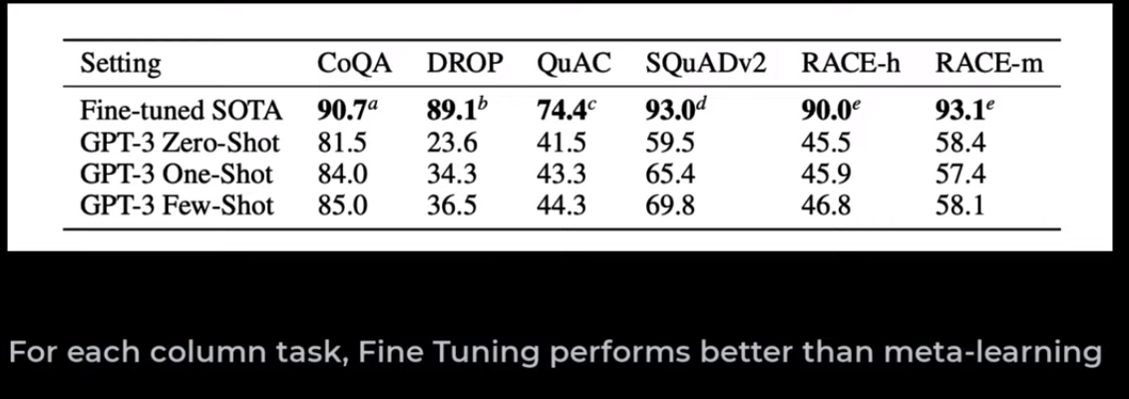

Slide 57
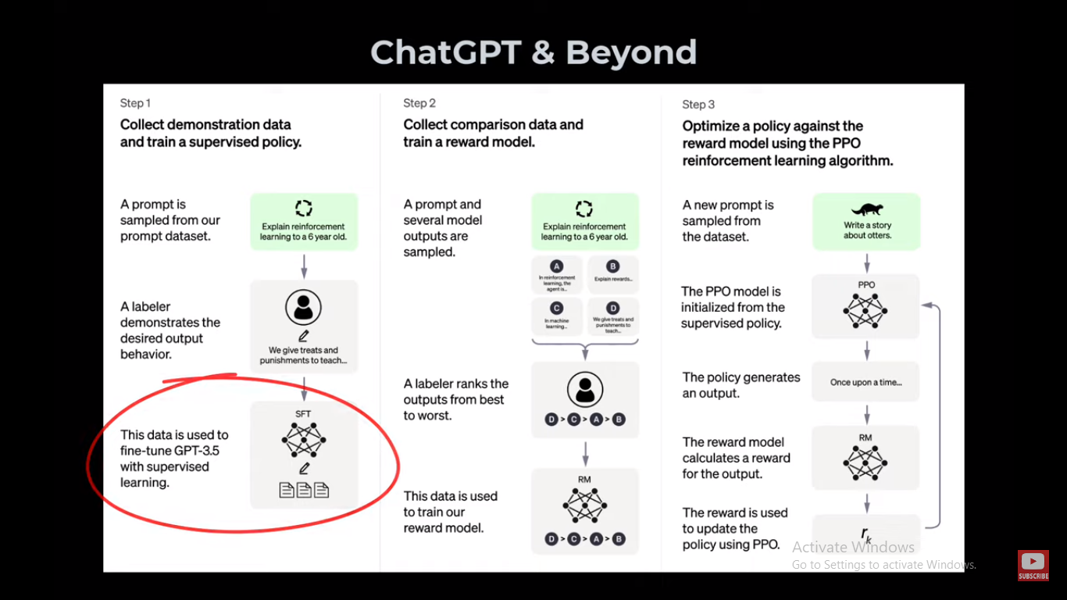

Slide 58


Slide 59

LET’S DIVE INTO THE HAND’S ON PART

Slide 60

Its time for Action!

Slide 61
THANKS!
Any questions?

Slide 62
JAI GANESH 8122716635 ganesh92jai@gmail.com

